Slide 1
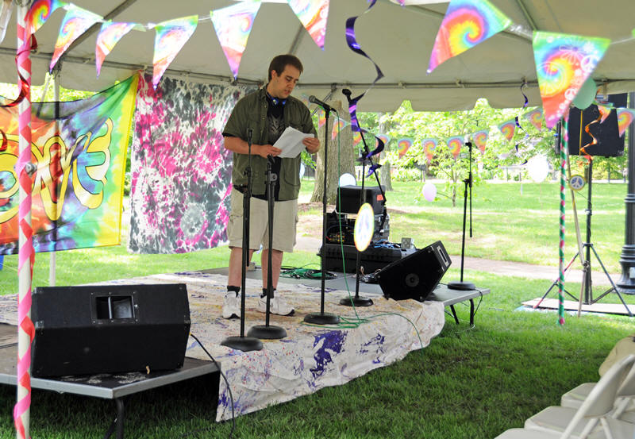
Event Production Tutorial

Slide 2
Planning an Event
Decide a range of dates
Speak with Facility Reservations to reserve a room and add our services
  https://www.salisbury.edu/reserve
  When reserving a room through Facilities Reservations and adding our services, please add all of the applicable equipment you will be needing for your event
  Example: Laptop and projector package, sound system package
  Note that once you request the specific technical services required at your event, additions are highly discouraged, as we may not be able to accommodate them. Please carefully plan your event so you avoid having to make additions/alterations to the reservation
If event is LESS than 2 weeks away from reservation date, you must fill out a Last Minute Event Services Request, which can be accessed here
  https://webapps.salisbury.edu/ets/workOrder

Slide 3
Planning an Event “continued”
After the venue has been reserved through Facilities Reservations and Event Technical Services has been added to the reservation, we will have record of your event.
  Please be advised that the scheduled end time of your event is the time that you will need to be out of the room, as there may be other events happening in those rooms after your event.
Keep in mind we will do our best to accommodate your event, but equipment is subject to availability
  The earlier you request a venue and our services, the more availability we will have to cover your technical needs for the event
If applicable, notify us regarding any rehearsal time for your event, along with what equipment you will be needing for the rehearsal.
If your event is lighting intensive, such as a dance show or fashion show, we will need a cue sheet with the details of your event
If there will be musicians, bands, or other outside performers coming to the event, we will need a technical rider from them.

Slide 4
Planning an event - continued
Using www.youtube.com videos at events is strongly discouraged, as the connection is highly unreliable
Find video exporter www.keepvid.com and copy and paste YouTube link there. Then provide video on a flashdrive for display in .mp4 or .wmv format
If applicable, have script/program available for Production Assistants (1 per person)
Step by step directions to plan a successful event can be found at the Event Technical Services webpage https://www.salisbury.edu/administration/student-affairs/guerrieri-student-union/event-technical-services.aspx

Slide 5
Performances and venue info
Limitations of each room:
  Wicomico
    This room is based on the lighting already available in the room. Color choices are extremely limited.
    The smaller the performance area the more options. The larger the area the less options.
    We do not have strobes or black lights available. Intelligent lighting limited to dance style random patterns which remain on.
  Holloway Hall
    Lighting subject to the touring events proceeding and following your event.
    The backdrop can do colors that are a combination of RGB Specials are subject to crew availability for hang and focus.
    We do not provide props
In all areas DJ's are NOT allowed to tie into our system and we can NOT supplement their equipment with our equipment or vice versa
MEETINGS CAN BE SCHEDULED WEEKS IN ADVANCE TO CHECK OUT FACILITY AND PLAN FOR YOUR EVENT

Slide 6
Day of Event Procedures
CALM and ORGANIZED
Use time in room for spacing, not rehearsal
Have any playback organized in a playlist IN SHOW ORDER, clearly labeled according to program
Designate a single point of contact for the crew at the event. All info should come through this person to minimize confusion. This person should not be in the show or production.

Slide 7
Day of Event “continued”
Respect the room and be aware. Theatres are an easy place to get hurt, no matter how safe we make it. Be aware of sharp, hot, mobile, and heavy objects. Open-toed shoes must be aware of sharp objects and cords on the floor.

Slide 8
Cancelled events
Notify us ASAP if your event has been cancelled
  sueventtech@gmail.com

