Slide 1

2019
Legislative Session

Slide 2
2019 Legislative Session
University System of Maryland - Board of Regents - Transparency and Oversight
University of Maryland University College - National Footprint Campaign – Renaming
Legal Representation for Title IX Proceedings
Labor and Employment - Payment of Wages - Minimum Wage and Enforcement
minimum wage rate will increase by 75 cents per year
Notes:
Need title

Slide 3
2019 Legislative Session
State Prescription Drug Benefits - Retiree Benefits – Revisions
Interagency Agreements
each State agency and each public institution of higher education shall report potential expenditures in excess of $100,000 over the term of the agreement.
Interagency Agreements – Historically Black Colleges and Universities – Reporting Requirements
Academic Research - Medical Uses and Properties of Cannabis
Notes:
Need title

Slide 4
2019 Legislative Session
MISC Items
$300k for Entrepreneurship Center
Student Debt Relief Act
Kirwan
Athletic Concerns Survey
Speaker
Notes:
Need title

Slide 5
Other:
3% COLA Increase effective July 1
State appropriation to SU: $1.8M
SU COLA for CII, Adjuncts: $250,000
Minimum Wage Bill: Effective January 1, 2020
Now: $10.10
January 1, 2020 = $11.00
January 1, 2021 = $11.75
January 1, 2022 = $12.50
January 1, 2023 = $13.25
January 1, 2024 = $14.00
January 1, 2025 = $15.00
Notes:
Need title

Slide 6
FY19 Update

Slide 7
Credit Hour Trends

Slide 8
CURRENT FY19 SU Budget
Thru March: Revenues up .98% - $1.7M
Thru March: Expenses up 4.14% - $3.3M
If current FY19 revenues/expenses hold = lowest fund balance contribution in recent memory
After 1% FB + 2% FacRen + AuxPlant = less than $500k margin……
(Spending freeze?)
Notes:
Revenues up .91% = $907,116
Expenses up 3.30% = $2,261,903
Unbudgeted spending = $337K (this figure represents net budget adjustments made after the Day 1 budget for FY19—does not include the encumbrance rollover)
BZ 021719
Revenues up 1.33% = $2,280,856
Expenses up 4.00% = $
Unbudgeted spending = $337K (this figure represents net budget adjustments made after the Day 1 budget for FY19—does not include the encumbrance rollover)

Slide 9
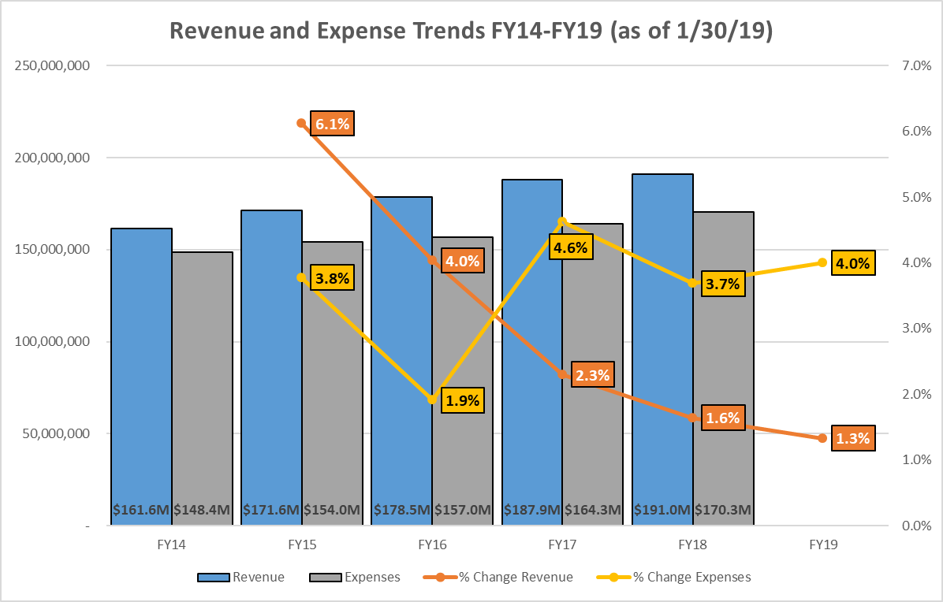
SU Budget Trend
Notes:
Updated through Nov

Slide 10
SU Budget Trend
(as of 4/1/19)
4.14%
.98%
Notes:
Updated through Nov

Slide 11
2020 Budget:
New Budget Model - Decentralization

Slide 12
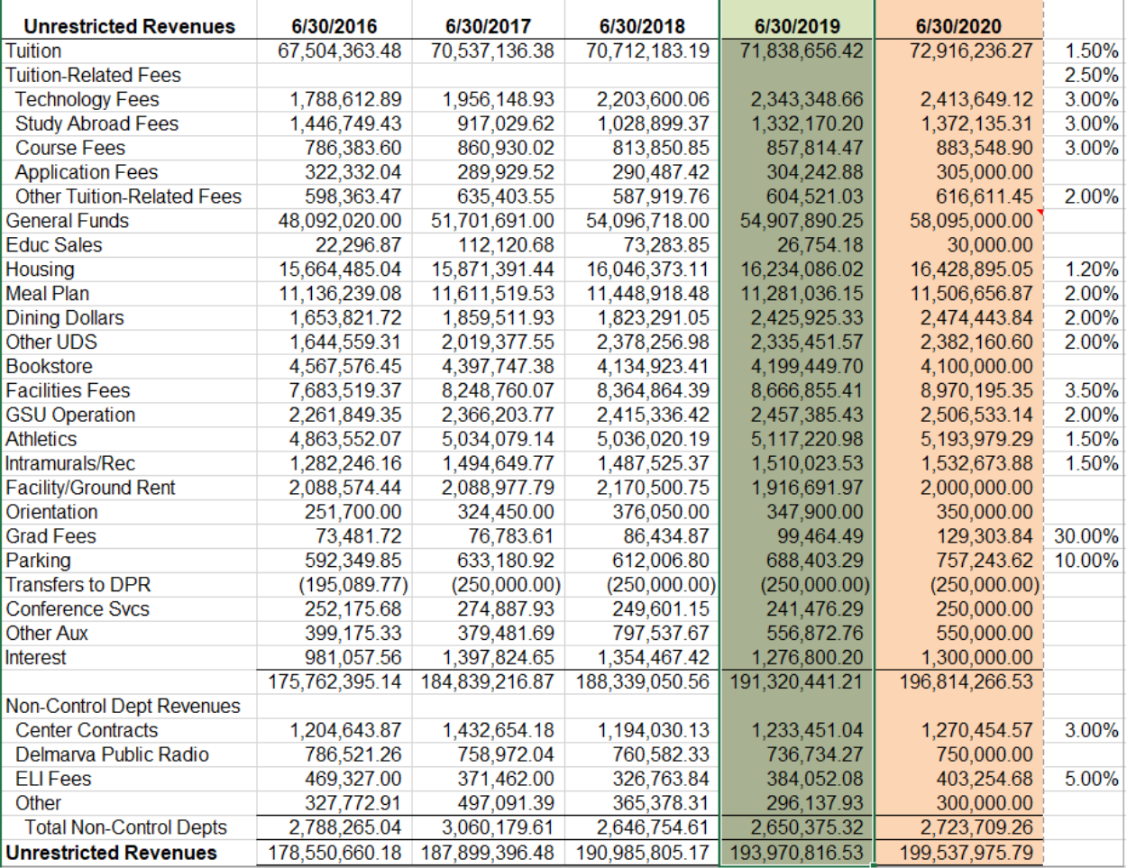
FY20 Budgets: Revenue Projection
Notes:
Need title

Slide 13
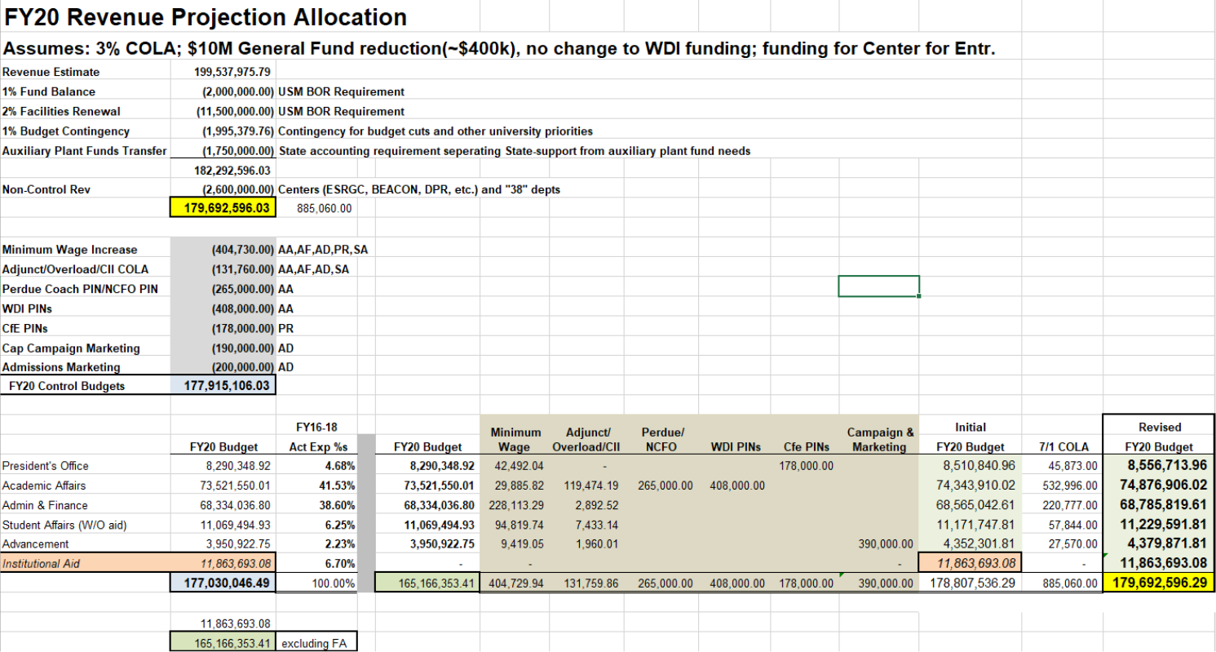
FY20 Budgets
Notes:
Need title

Slide 14
Notes:
Need title

Slide 15
FY20 Budgets:
May 1 deadline
VP deadlines
01 and 02 increases
COLA, minimum wage
USM Non-exempt Pay Program changes
More compression.…..!!
Notes:
Need title

Slide 16
“Issues/Concerns”
“Tight budgets”
Fully funding 01 leaves less for 02/03
Decisions that have campus-wide impact
Human Resources
Procurement
Other Questions??
Notes:
Need title

Slide 17
FY20 and Beyond:
Notes:
Need title

Slide 18
USM Nonexempt Salary Structure

Slide 19
USM: Unfunded Mandates
Nonexempt and Exempt Salary Structure adjustments
Review Year | Effective Date | Cost Impact
2018 NE | 7/1/2019 | $44,583
2016 NE | 7/1/2017 | $97,514
2014 NE | 7/1/2015 | $55,120
2012 NE | 1/1/2014 | $126,878
2010 NE | 7/1/2011 | $0
2008 NE | 7/1/2009 | $70,917
 |  | $395,012
2017 EX | 7/1/2018 | $0
2015 EX | 1/1/2017 | $93,711
2013 EX | 7/1/2014 | $19,369
2011 EX | 7/1/2012 | $52,560
2009 EX | 7/1/2010 | $0
2007 EX | 7/1/2008
 |  | $165,640
 |  | $560,652

Slide 20
Faculty Pay Study

Slide 21
Faculty Pay Study

Slide 22
Exempt Pay Study

Slide 23
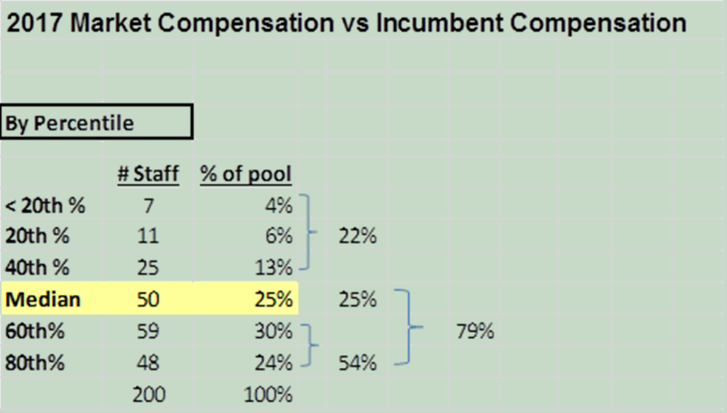

Exempt Pay Study

Slide 24
QUESTIONS?

Slide 25
FY2018
Revenues & Expenditures

Slide 26
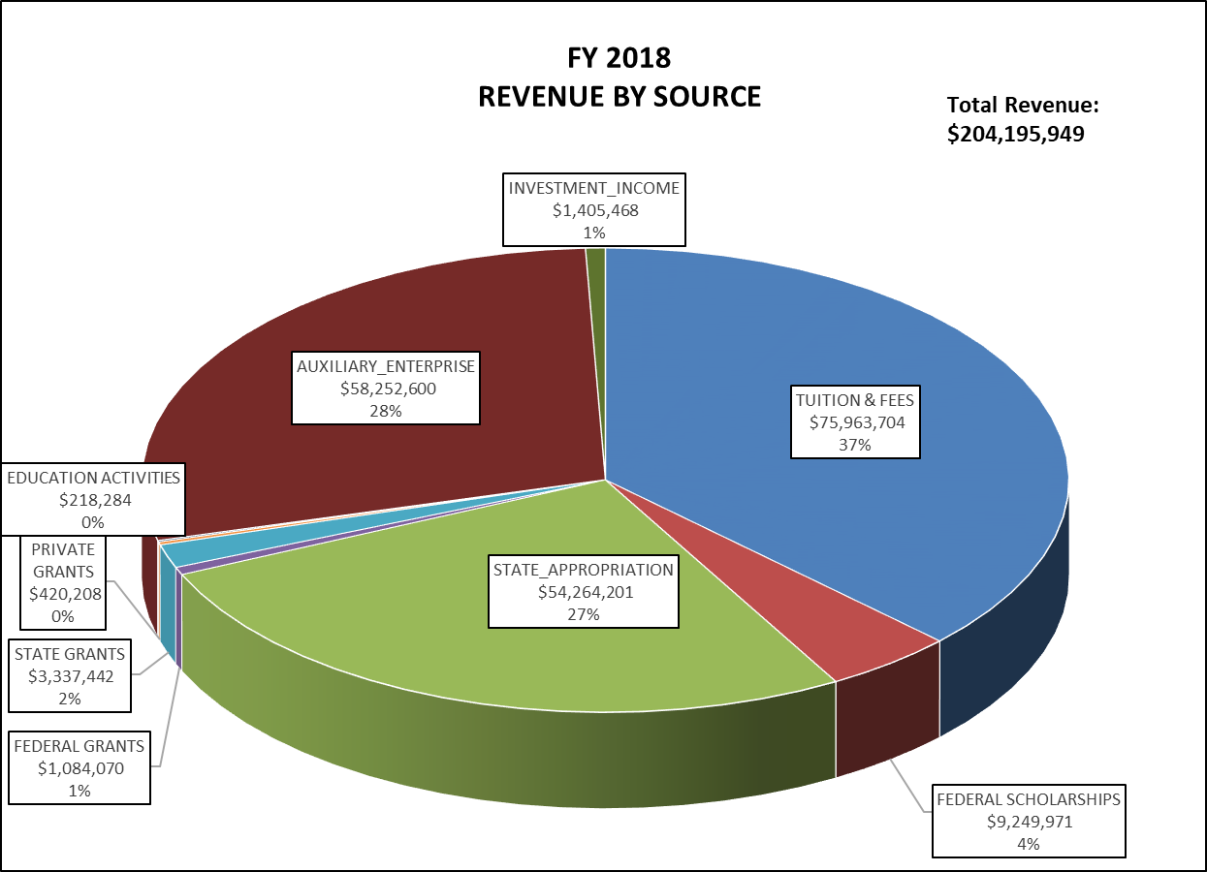
REVENUE BY SOURCE

Slide 27
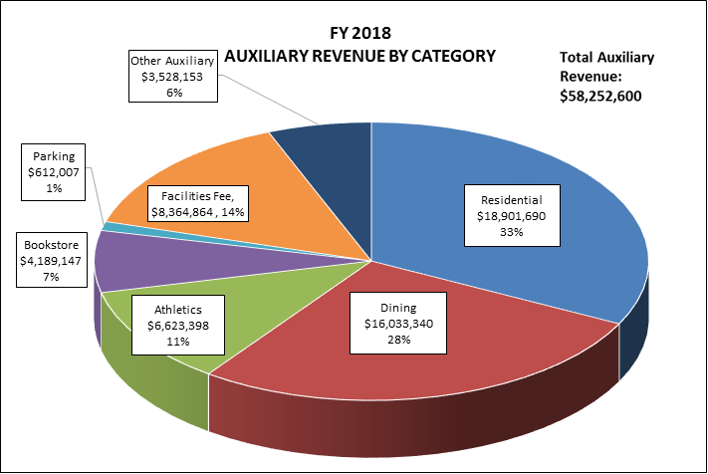

Slide 28
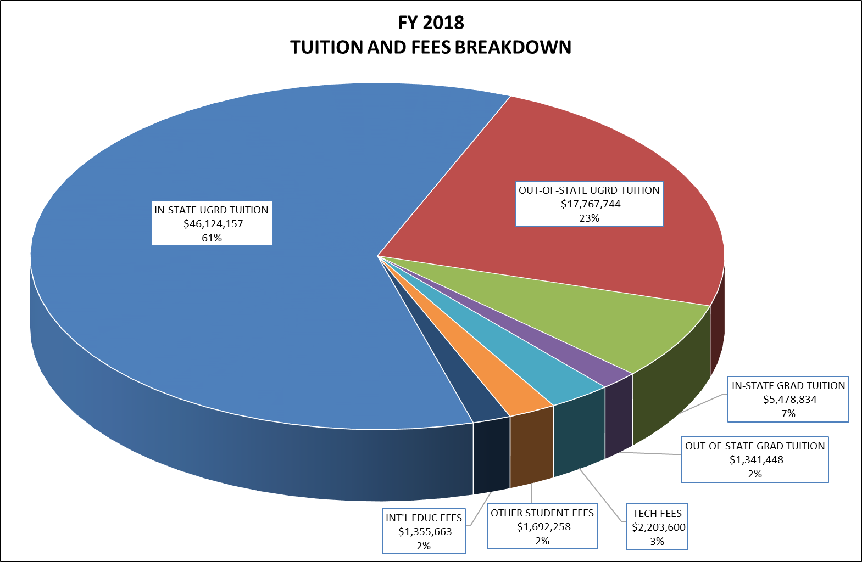

Slide 29
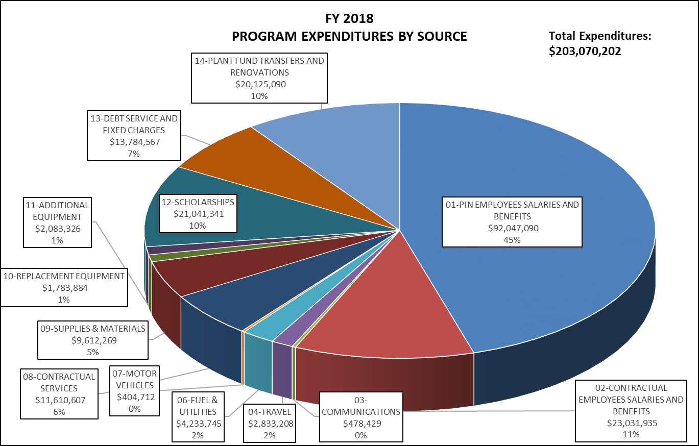
FY18 EXPENDITURES BY SOURCE

Slide 30
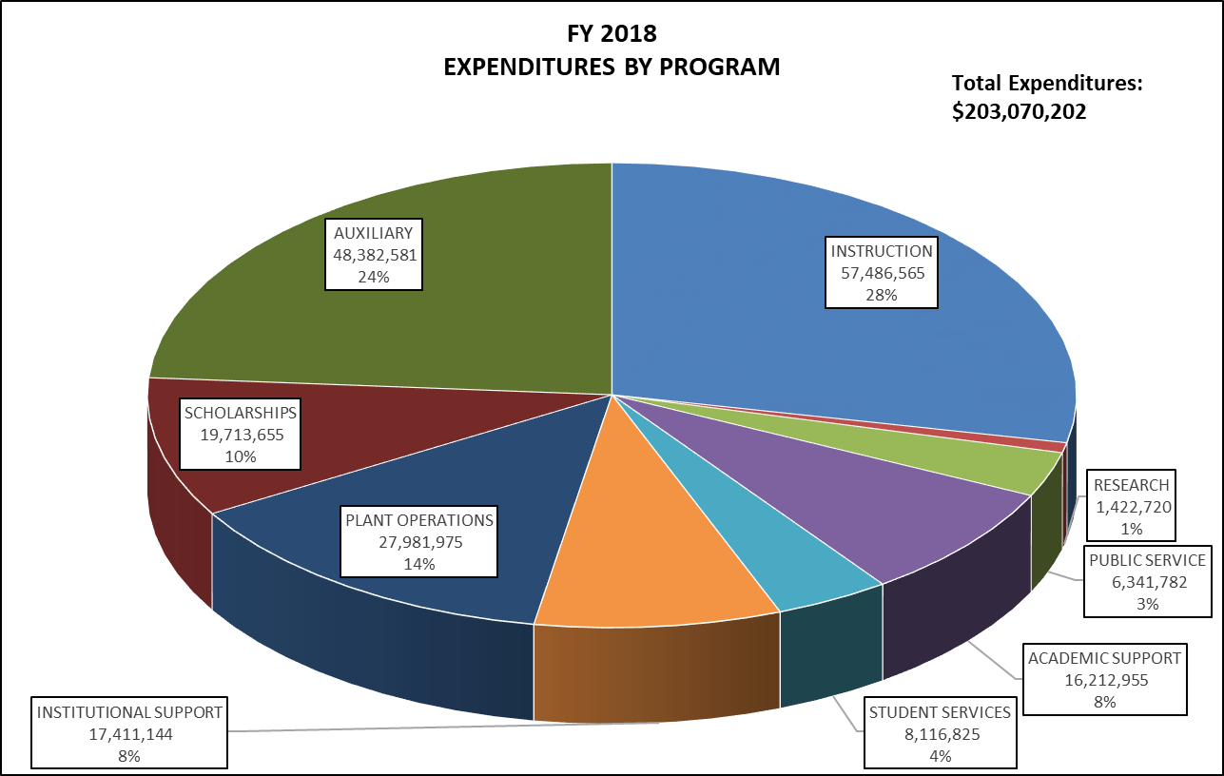

Slide 31
Upcoming FY20 Budget Picture: State & USM: Minimum Wage Bill
Escalation to $15 minimum wage
SEVERE impact on SU
2019 = $749,468
2020 = $1,091,201
2021 = $1,165,408
2022 = $1,338,407
2023 = $1,301,941
$5,646,425

Slide 32
Upcoming FY20 Budget Picture: State & USM: Minimum Wage Bill
To correct for potential
Non-Exempt Compression:
To correct for potential Faculty/Exempt Compression
2019 = $885,901
2020 = $1,657,860
2021 = $3,269,263
2022 = $2,598,991
2023 = $2,726,301
$11,138,316
2019 = $7,696,626
2020 = $7,516,221
2021 = $7,282,384
2022 = $7,570,037
2023 = $7,411,756
$37,477,024

Slide 33
SU Budget Trend
233,483
234,206
232,927
231,153
234,116
231,415
228,519
Notes:
I added in the actual SCH for each year

Slide 34
FY16-FY19 BUDGET INCREASES
FY2017
 | 01 % Increase | 02 % Increase | 03-13 % Increase | Total % Increase
 | 5.41% | 8.37% | 2.14% | 4.22%
 | 01 % Increase | 02 % Increase | 03-13 % Increase | Total % Increase
 | 4.58% | 3.88% | 6.61% | 5.26%
 | 01 % Increase | 02 % Increase | 03-13 % Increase | Total % Increase
 | -.09%* | 5.93% | -.43% | .50%
 | 01 % Increase | 02 % Increase | 03-13 % Increase | Total % Increase
 | 10.14% | 19.26% | 8.42% | 10.25%
FY2018
FY2019
TOTAL
*Note: FY19 01 budget was “reduced” as (1) PINs were moved out of control-budgeted departments = $650K, and (2) adjustment of previously overstated costs, mostly in benefits.
Actual total FY19 increase would have been 1.05%, equaling three year total of 10.85% in 01 and 10.64% overall.
Notes:
For FY19, 01 shows a decrease. There are several factors impacting the 01 budget for FY19:
The FY18 “Day1” budget for 01 had actually already been increased by $350K
The FY19 “Day 1” budget was affected by us moving 8 PINs (either fully or partially) out of control-budgeted departments. This was an 01 reduction of approximately $650K.
When Joanna and I budgeted for 01 for FY19, we took a lot of time to create a query/model based on actual benefit selections. In comparing our 01 budget to the FY18 budget and actuals, there were definite instances where the 01 budget had been overstated in FY18 (mostly in benefits). I don’t have a calculated figure to represent this overall difference, but it is impacting the comparison of 01 budgets between the two years.
Based on the first two bullets, if you factor in this $1M difference in 01 between FY18 and FY19, there would have been an 01 percentage increase of .9% and a total FY19 increase of 1.05%. The three year total difference would have been 10.85% in 01 and 10.64% overall.

Slide 35
Questions?

Slide 36
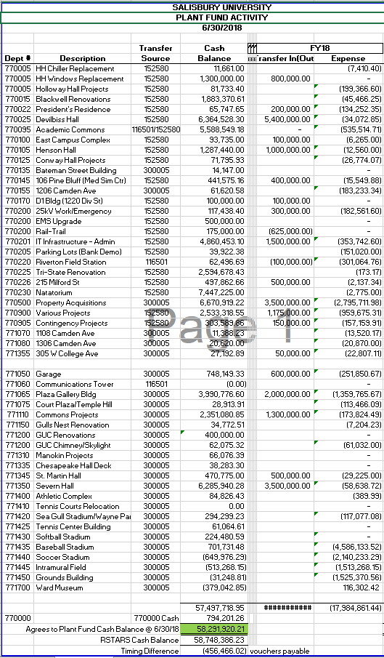
Plant fund Projects

Slide 37
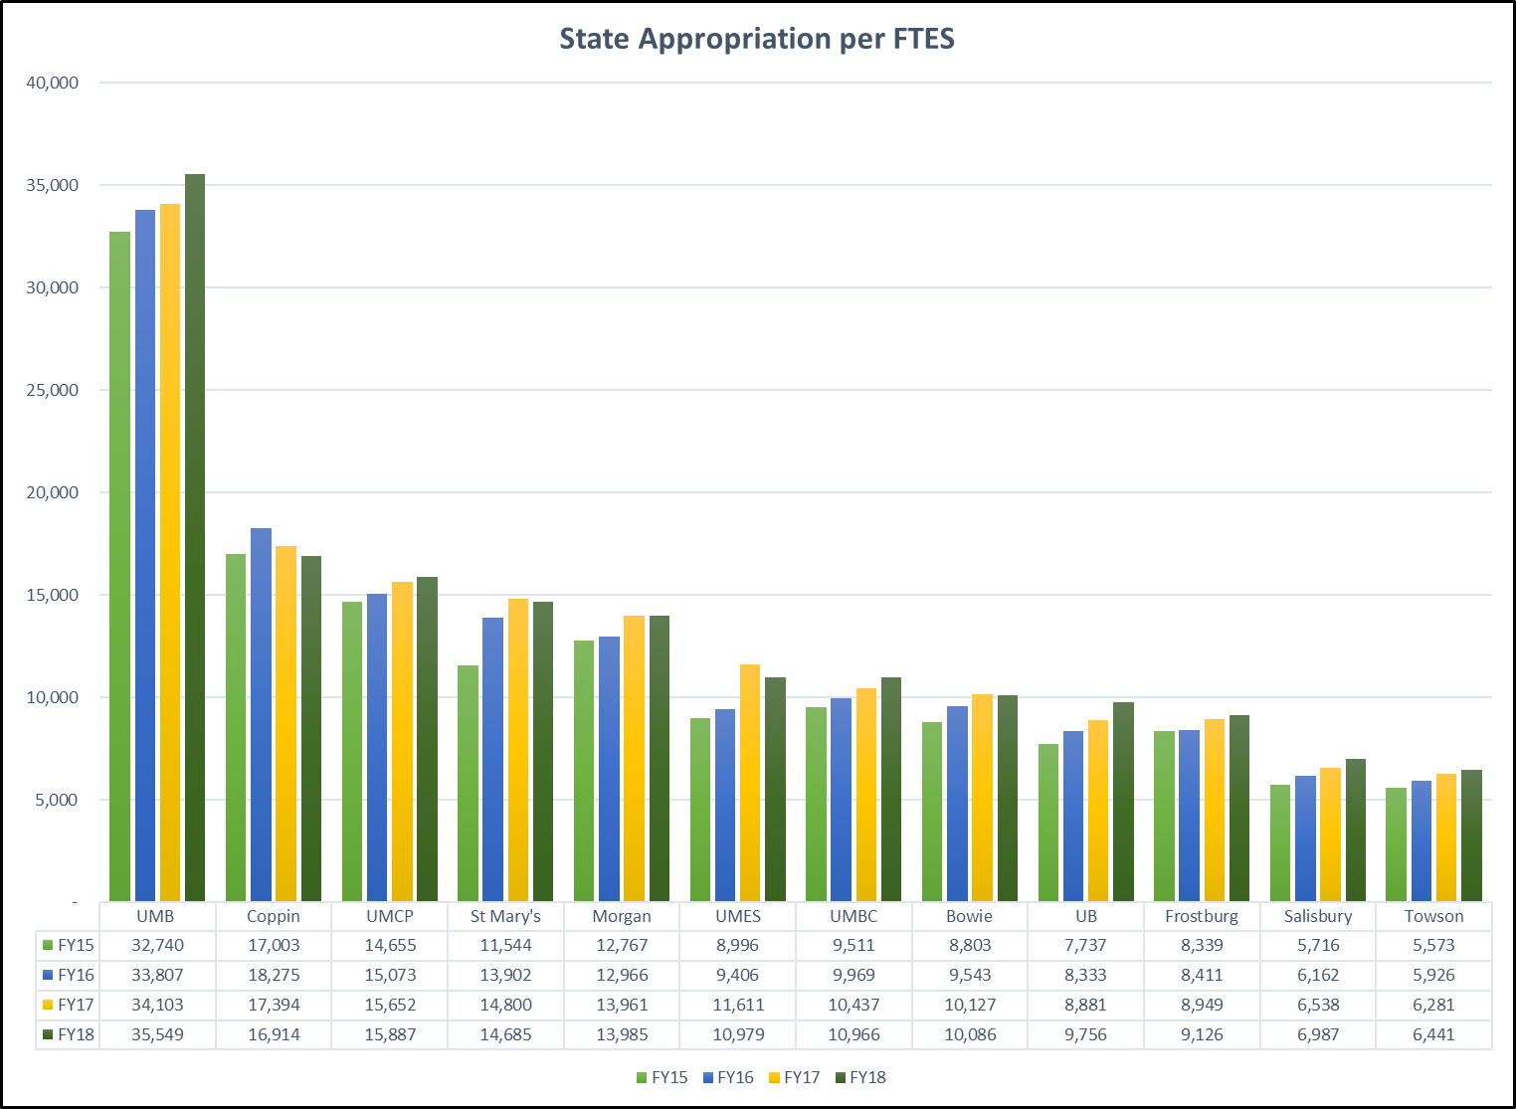
SU Budget Trend
Enrollment is Irrelevant for General Funds

Slide 38
Revenue from Enrollment Growth Tuition & Fees is NOT the only answer:

Slide 39
Revenue from Enrollment Growth Tuition & Fees is NOT the only answer:
Does NOT address: hiring more faculty, housing, parking, plant operations, auxiliary, classroom space, etc. ….

Slide 40
Additional Information:

Slide 41
Historical Growth: Budgets & PINs

Slide 42
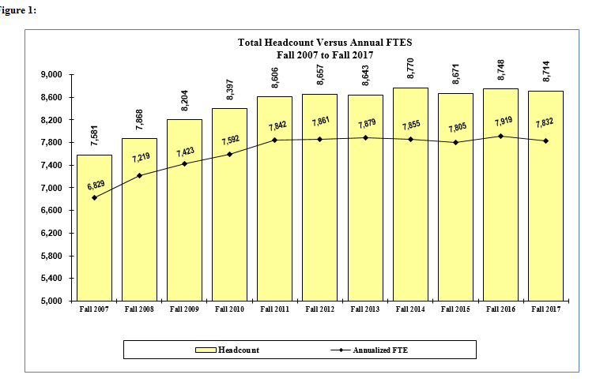
Student Headcount
15%
Notes:
% change in headcount is correct

Slide 43
PINs
22%
25
Vacant PINs
Notes:
Eliminate this slide—data not matching the rest of the PIN slides in the year to year counts—remaining PIN slides are all drawn from the same query—this slide was one of our earlier attempts to pull PIN data together.

Slide 44
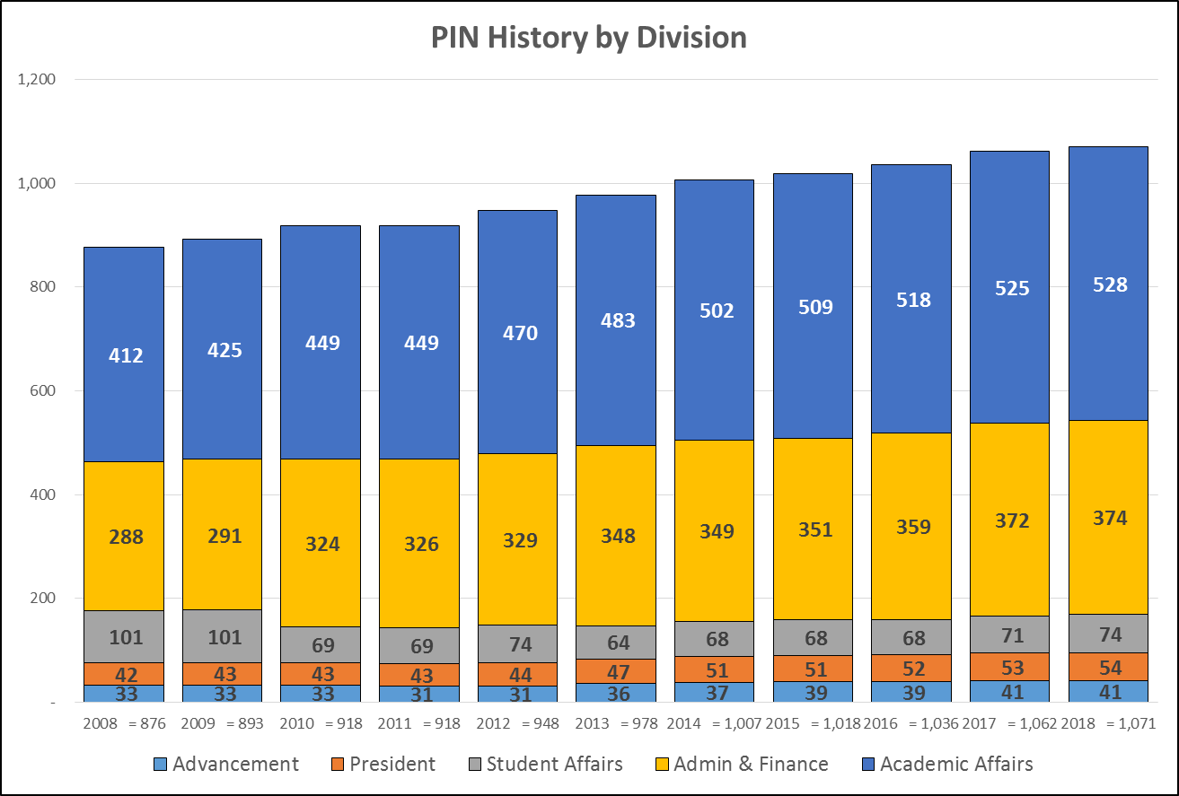

Slide 45
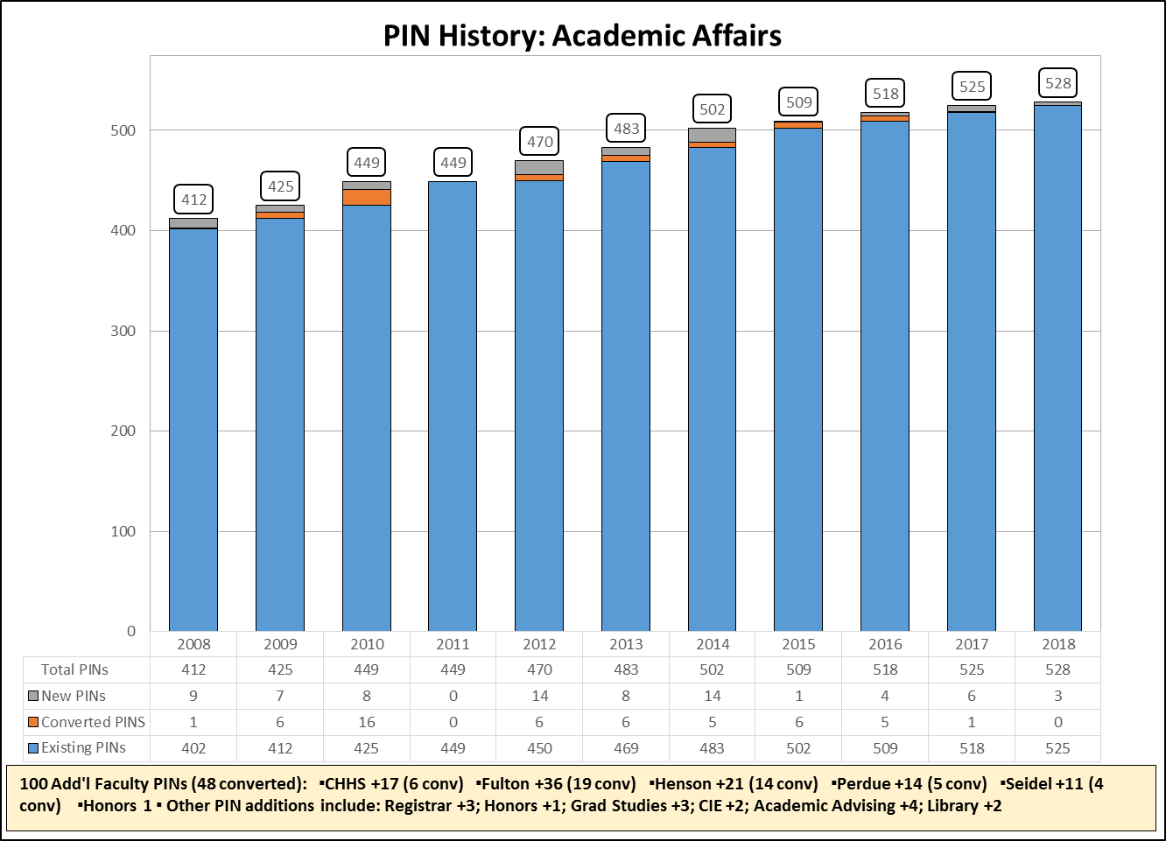
28% New PINs
16% non-CII PINs
77% of increase were “new faculty” (52 of 68 non-CII-converted positions)
*does not include 1 converted PIN from 2008
Notes:
528-412 = 116 additional PINs – 51 that were converted = 65/412 = 15.5%
Did not include 2008 converted PIN of 1 in calculation—already part of the 412 beginning balance

Slide 46
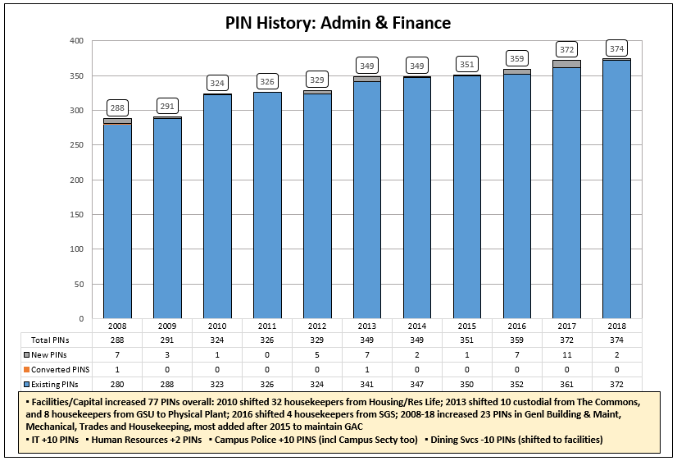
14% New PINs
2007 – 59 buildings: 1,458,999 GSF
2017 – 91 buildings: 2,510,827 GSF
72% increase
Notes:
14% = new PIN count of 39 (from 2009 forward) divided by 288
Is this right? Do we need to factor in the transfer of PINs from Student Affairs? Probably not…

Slide 47
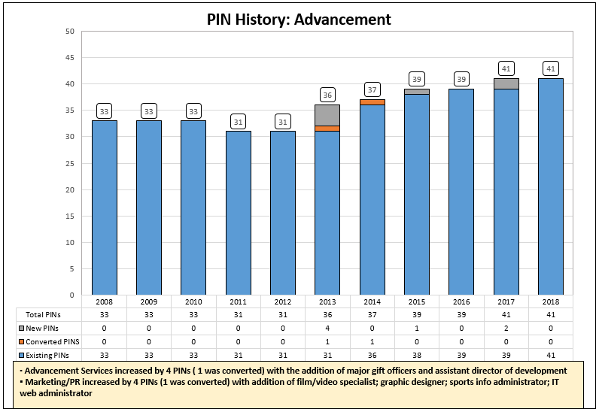
18% New PINs
Notes:
41-33 = 8 PIN increase -2 that were converted = 6/33 = 18%

Slide 48
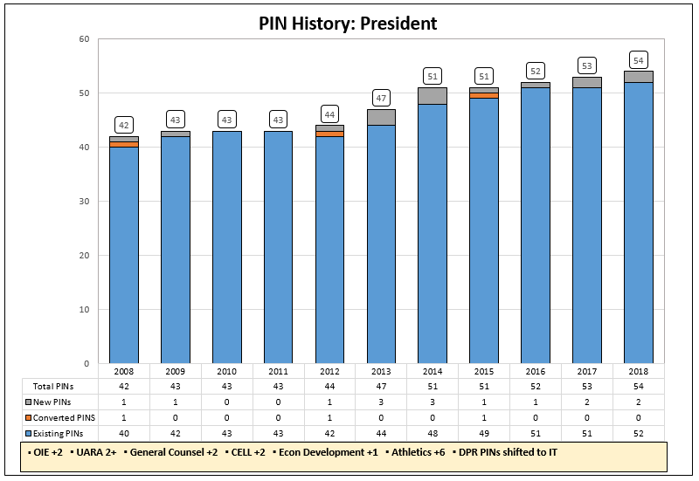
33% New PINs
Notes:
14 New PINs (2009-forward)/42 = 33%

Slide 49
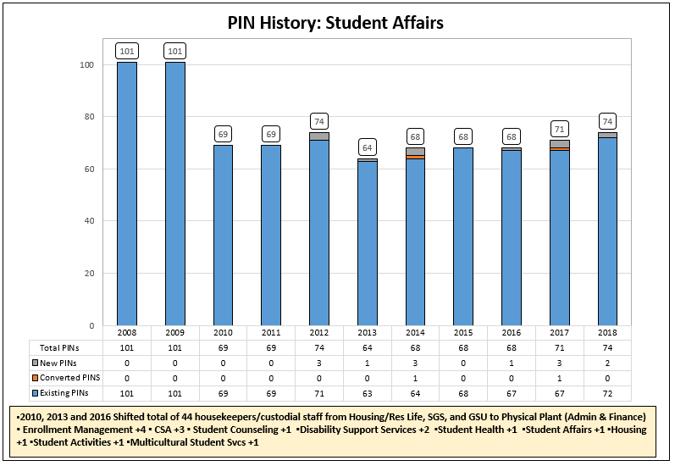
28% New PINs
Notes:
Not sure on this %--how to factor in large PIN transfer to Admin and Finance?

Slide 50
Financial Information:

Slide 51
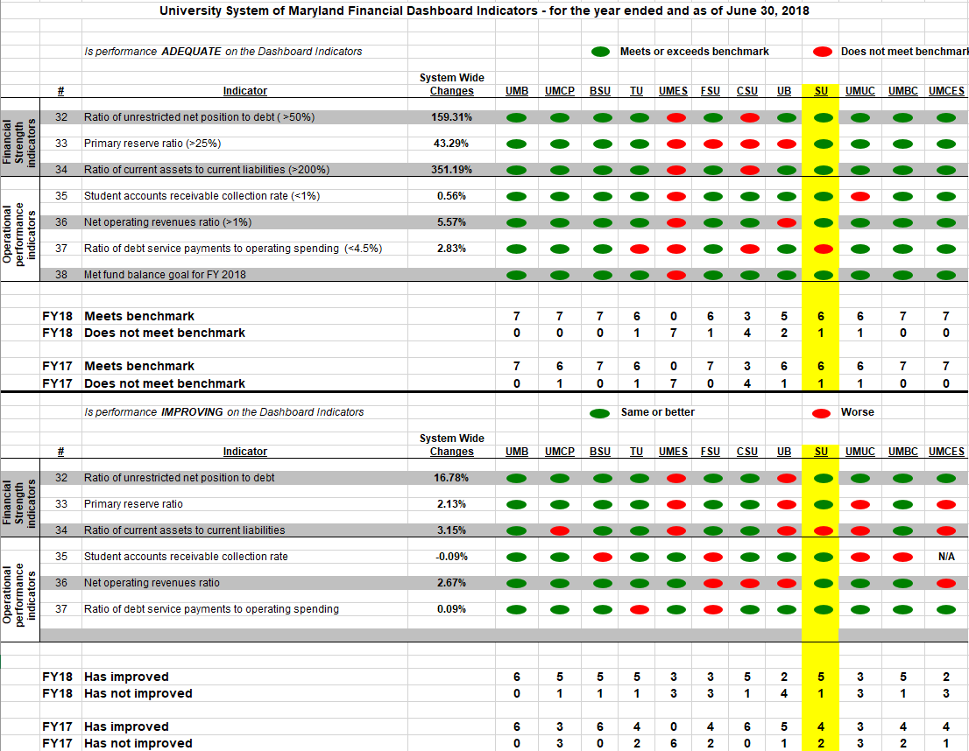
USM Dashboard Indicators

Slide 52
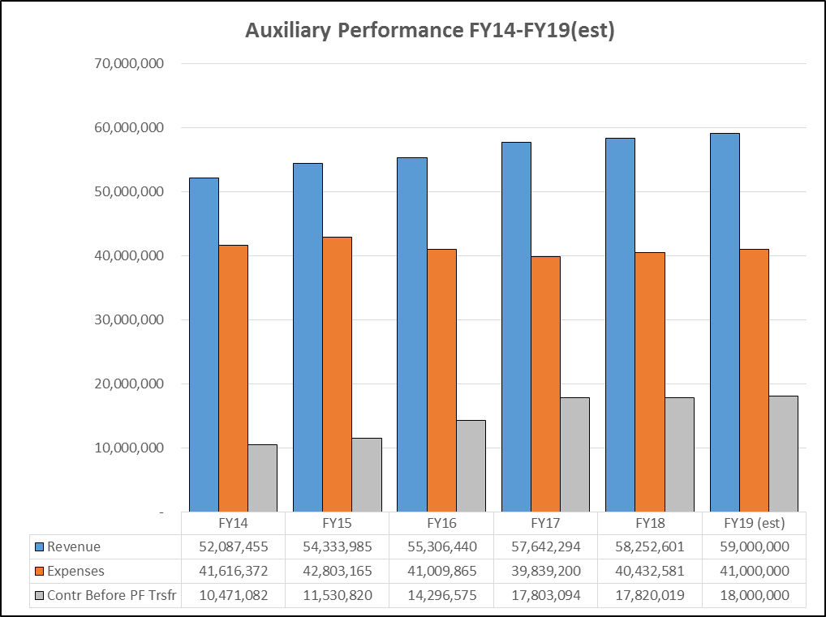
Auxiliary Performance FY14-19

Slide 53
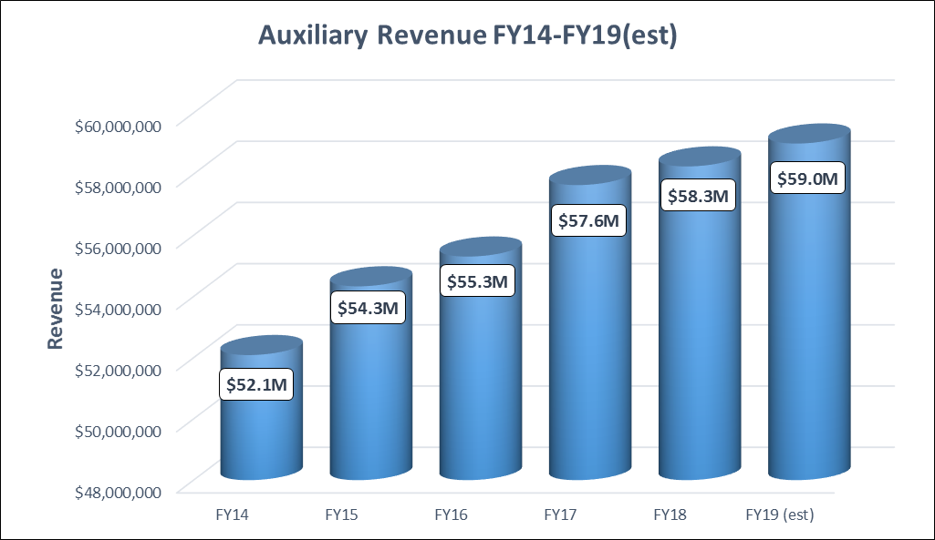
Auxiliary Revenue FY14-19

Slide 54
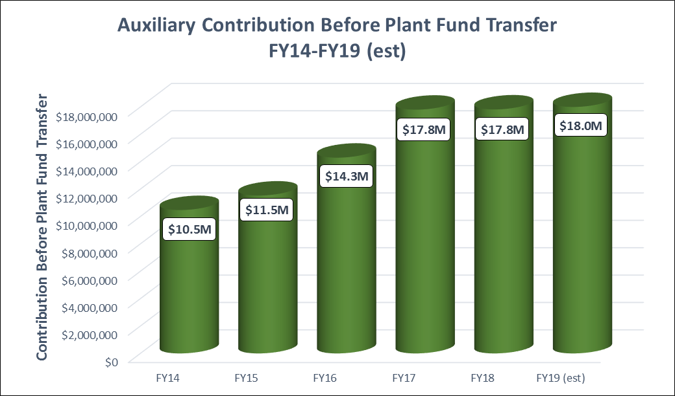
Auxiliary Contribution FY14-19 (Before Plant Fund Transfer)

Slide 55
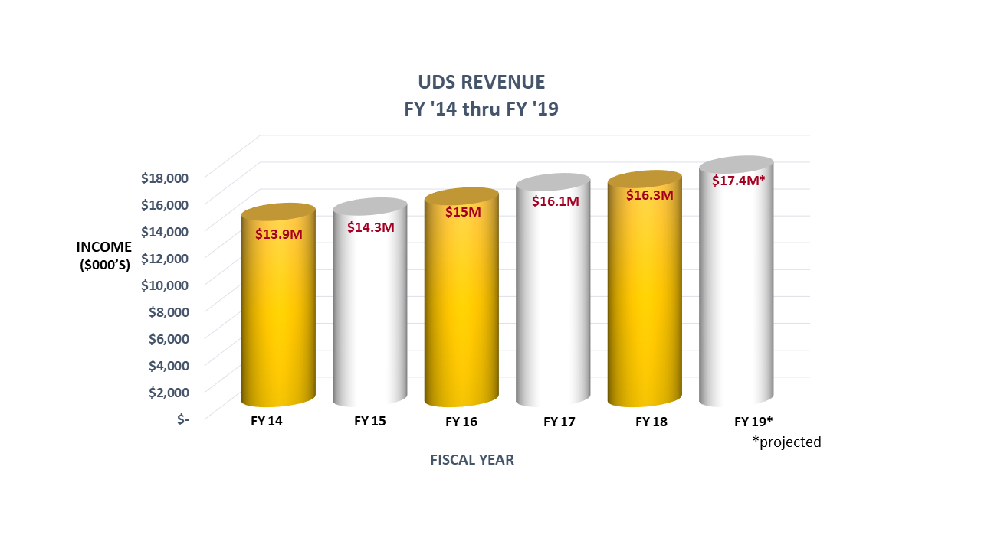
UDS: Auxiliary Revenue
Notes:
DELETE

Slide 56
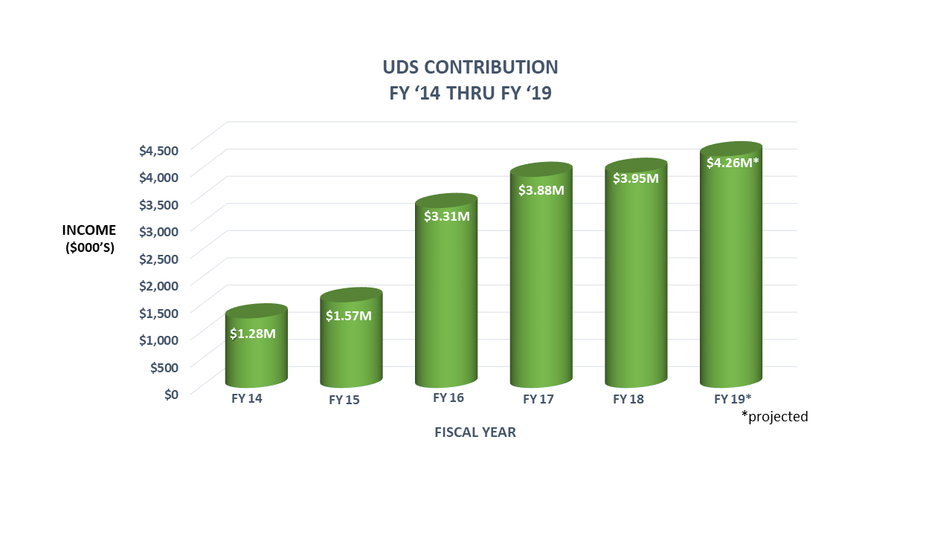
UDS: Auxiliary Revenue
Notes:
DELETE

Slide 57
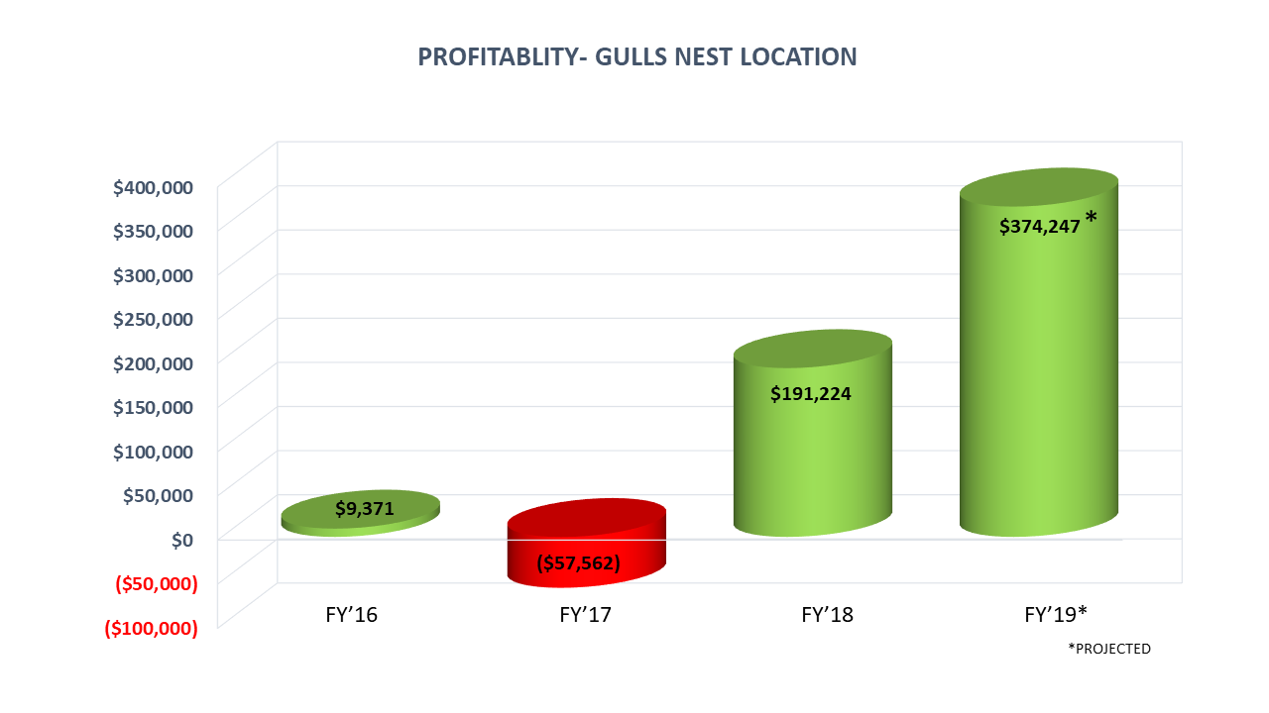
UDS: Auxiliary Revenue
Notes:
DELETE

Slide 58
USM Data Points and Legislative Testimony:

Slide 59
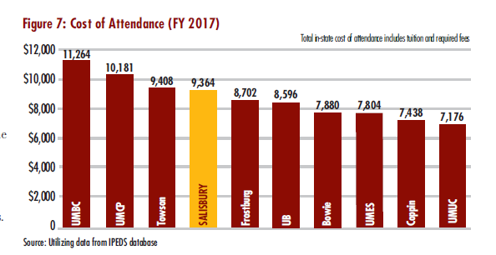
Cost of Attendance

Slide 60
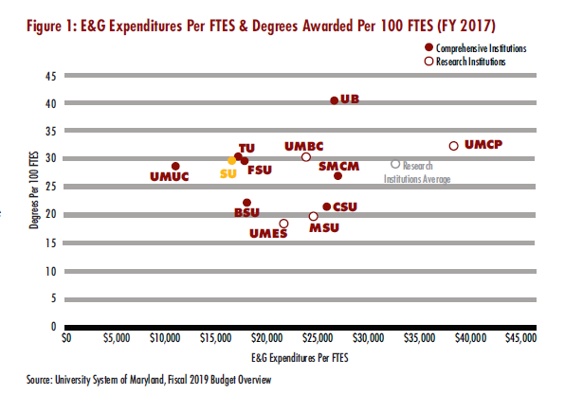
Cost to Produce Degree

Slide 61
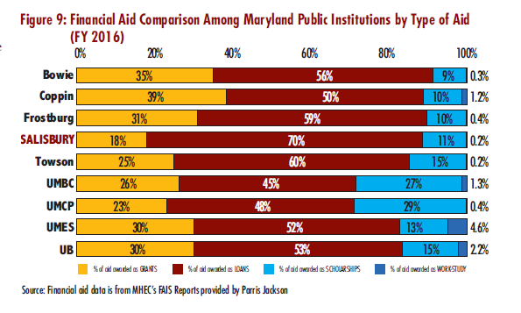
Financial Aid / Student Loans

Slide 62
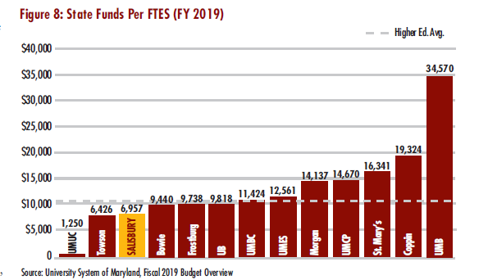
Appropriation per FTE
Enrollment is Irrelevant for General Funds

