Slide 1
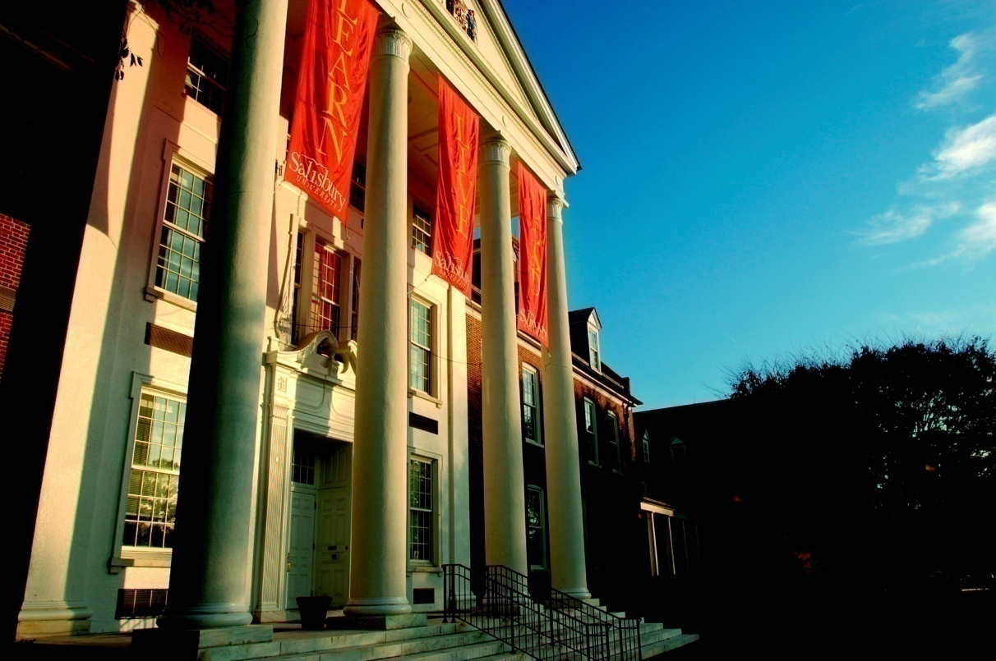
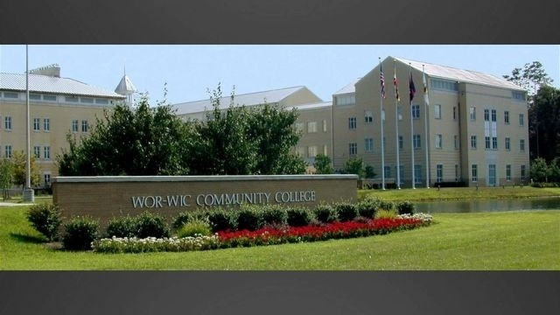


SU Bridges:
A Partnership between Salisbury University and Wor-Wic Community College –
A Report to the Salisbury University
Faculty Senate
SALISBURY
A Maryland University of National Distinction

Slide 2
Rationale
SU Bridges provides educational access and opportunity for incoming students who may not have the ideal admit profile but demonstrate potential for academic success.

Slide 3
Context
Fall 2011: Started as “Fall Fusion”
Fall 2014: Changed name to “SU Bridges”
Signed MOU govern the partnership
Approximately 30 students participate each year
Participating students take Wor-Wic classes taught by Wor-Wic faculty on SU’s campus
Students may take an SU course that satisfies GenEd
Participating students live on campus and experience regular university and residential life except participation in living-learning communities

Slide 4
Context Continued
SU offers admission to the Bridges Program to SU applicants who are not admitted for fall to SU but would be offered admission in following spring
Center for Student Achievement serves as the “home base” for Bridges students
Students sign a Participation Agreement

Slide 5
Academic Program Design
15 credit hours (WWCC Curriculum)
  Intro to Sociology
  Introduction to Philosophy
  Fundamentals of Oral Communication
  Integrated Health and Fitness
  US History
Participation in orientation
Academic advising
Academic coaching and mentoring
Transition to college course
Tutoring

Slide 6
Assessment Methodology
Data source: UARA
Types of Data:
  GPA
  Retention
  course completion rates
  graduation

Slide 10
Potential Opportunities
Expansion or replication of existing model
Exploration of other opportunities to promote educational access and opportunity
Transfer-specific opportunities

Slide 11
Conclusions
SU Bridges appears to have positive effects on students’ academic outcomes
SU Bridges program design appears to be sound and anchored in research-based academic support models
Opportunities exist to enhance, expand, or replicate SU Bridges
More research is needed on the “special sauce” or “x-factor” that also contributes to student success (e.g., family, faith, resilience, etc.).

Slide 12
Thank you.
Q&A

Slide 13
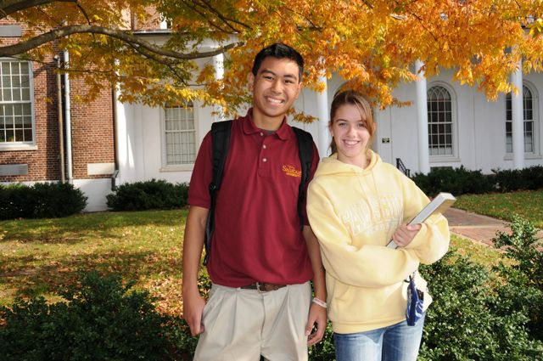
Salisbury University
A Maryland University of National Distinction
SALISBURY

