Slide 1

Agenda: 8-21-18
SPBC Committee
Strategic Planning best practices
Reviewing trends - National, State
SU Budget Trends
Student Affairs: Noel Levitz
Homework: Trends Survey

Slide 2
Strategic Planning and Budget Committee MEMBERSHIP

Slide 3
Upcoming/Pending Strategic Planning Schedule
September
Trends Survey: Top 5 in each area
Additional trend analysis
Introduction to SWOT
Academic Affairs update
Homework: SWOT Survey
October
Review of SPBC SWOT survey results
In-person SWOT analysis/breakdown
Refine timeline for campus vetting and focus groups
November – December – January (no SPBC)
Vet with governance groups

Slide 4
Upcoming/Pending Strategic Planning Schedule
February
SWOT comes back to SPBC
Refine and finalize plan to move forward
March – April
Conduct campus-wide Focus Groups
Assign SWOT trends and linkages to focus groups
Linkages become GOALS of the new Strategic Plan
Looking to drive Strategies for the plan
Assign to functional areas
May-June-July: Draft Strategic Plan

Slide 5
Upcoming/Pending Strategic Planning Schedule
July-August
Executive Staff, SPBC and Governance Groups review Draft
Sept: Distribute draft to Campus for final feedback
Sept-Oct-Nov:
Identify metrics
Develop implementation plan
December: finalize Strategic Plan
Implement January 1, 2020

Slide 6
Strategic Planning Best Practices

Slide 7
Strategic Planning Best Practices
Who are we?
What do we do? How do we do it? How well do we do it?
Do we really understand the external environment?
Have we Identified and qualified our competitors?
Should we SWOT or SWAT?

Slide 8
Strategic Planning Best Practices
What we must and what we should do?
Are we doing a good job of measuring our processes, our outputs, and our outcomes?
Are we Utilizing the 3 E’s (Effectiveness, Efficiency, and Evidence.)?
Do we know what to avoid?
Are we ready to be bold?

Slide 9
Trends in higher education

Slide 10
Social Trends
Free College Initiative
College Value vs. Alternatives
Credentialing
Filling the job pipeline
Safe spaces for LGBTQ community members
Increase in transfer students
Campus safety and free speech

Slide 11
Technology Trends
Mobile Learning
Block Chain
Big Data & Student Privacy
Cyberliablity Insurance
Changing the physical campus space
Expansion of digital humanities

Slide 12
Economic Trends
State competition for funding
International Competition
University Consortia & Outsourcing
College Affordability
Behind the Curve

Slide 13
Political Trends
Uncertainty of US International Affairs
Tax Reform & Budget Implications
Deferred Action from Childhood Arrivals (DACA)
Higher Education Act (HEA)
Faculty tenure
Local election uncertainty

Slide 14
Trends IN MARYLAND & USM

Slide 15
Political
Governor's Race
Legislature: Balance/Change
Economic Climate
Relationships with USM
(UM fallout?)

Slide 16
USM Enhancement
Category 1 – Campus programs:
#1: Creation of CHHS; requested $692,000; not approved…but “encouraged”
#2: Increase Computer Science Graduates; requested $292,000; not approved…but “encouraged”
#3: Increase Info & Decision Science Graduates - APPROVED
Category 2 – RHEC:
#1: Establish AHPH M.S. program at USG – “intention to provide support” (?)
Category 3 – Hagerstown/Shady Grove:
#1: Increase Social Work graduates at USMH - APPROVED
#2: Establish a Community Health Program at USMH - APPROVED
Total SU FY19 “investment”: $1.83M
Return, potential base funding: $1.2 - 2.2M per year

Slide 17
USM Budget Update
Creation of Chancellor’s Workgroup on Strategic Use of Institutional Aid
FY 2019 Working Budget
FY 2019 Health Controls – currently stable for 2020
Workforce Development Initiative – Year 1: required MOUs, updates for DBM and budget hearings, progress reports
Fund Balance – expectation to eliminate State Support Deficit

Slide 18
USM Budget Update
FY 2020?
FY 2019 COLA Annualization
Tuition caps
No New Positions
Facilities Renewal (FR) Increase
Fund Balance
Workforce Development Initiative – Year 2 funding
FY 2020 Target Reduction $26M – TBD
FY 2020 Enhancement Requests? – TBD

Slide 19
BUDGET Trends at SU

Slide 20
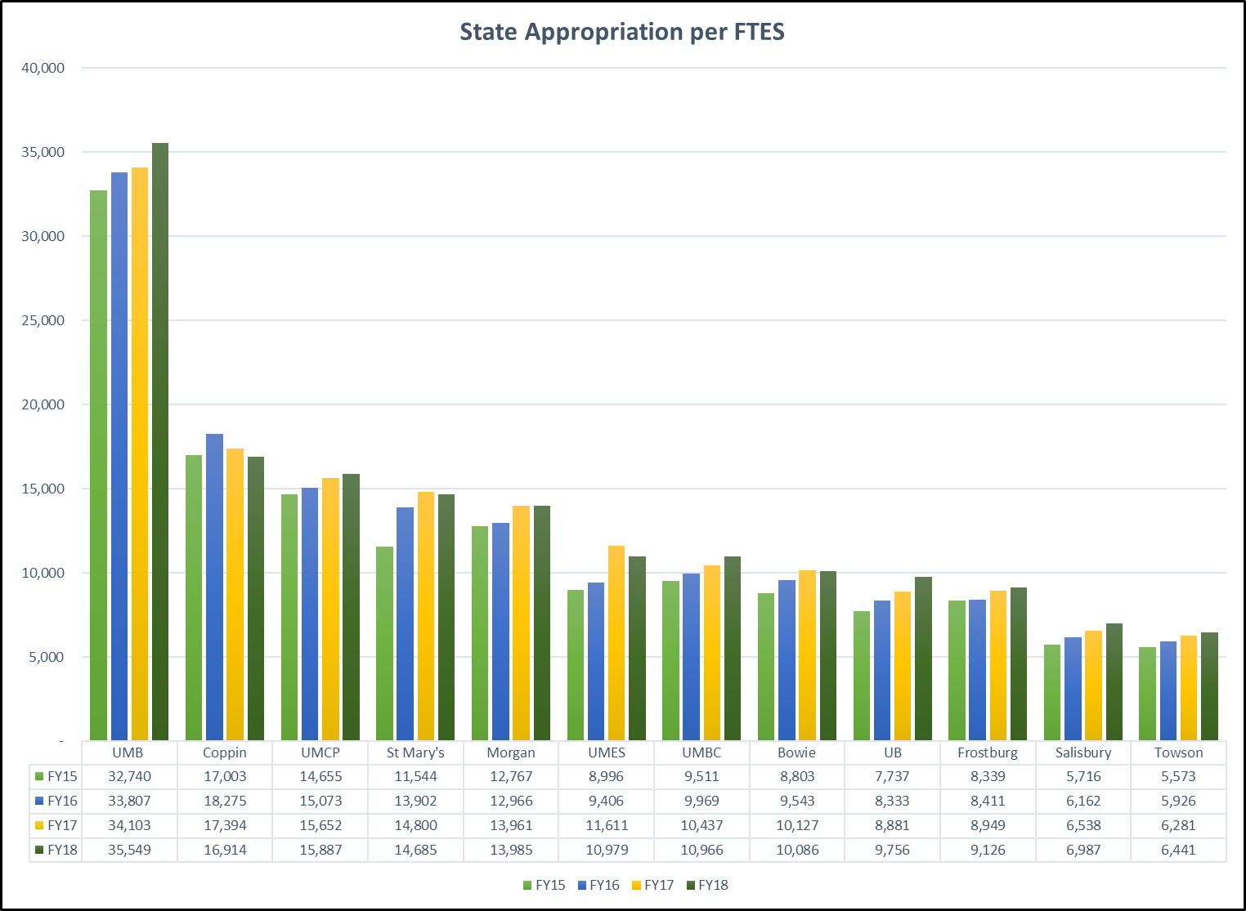
SU Budget Trend

Slide 21
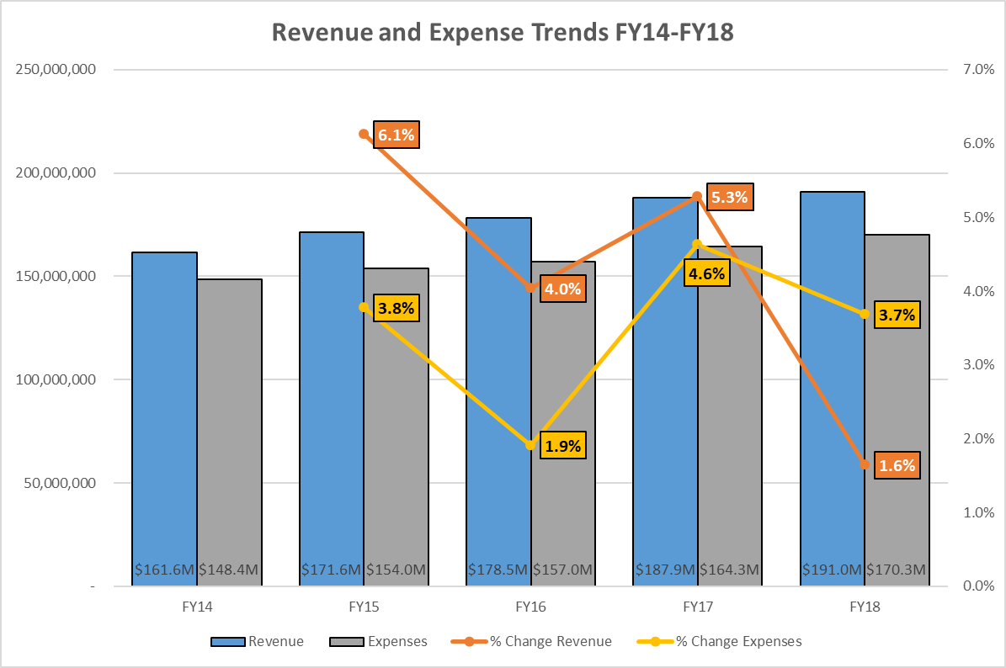
SU Budget Trend

Slide 22
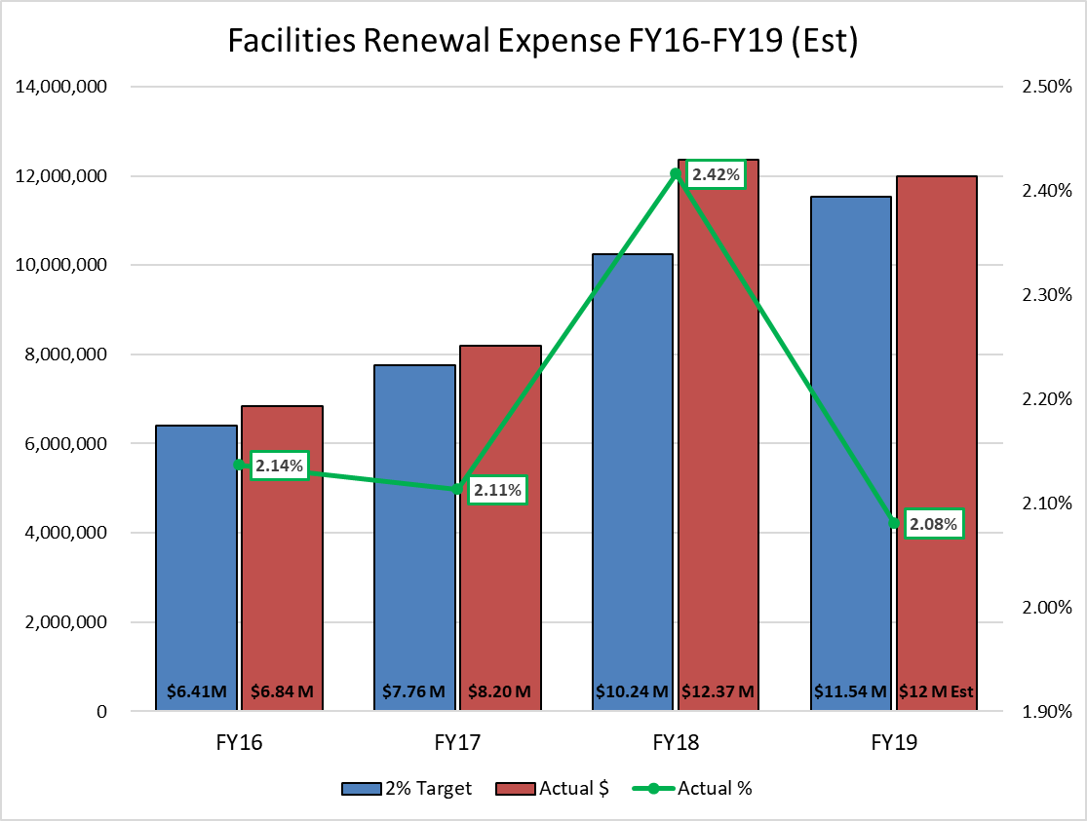

Slide 23
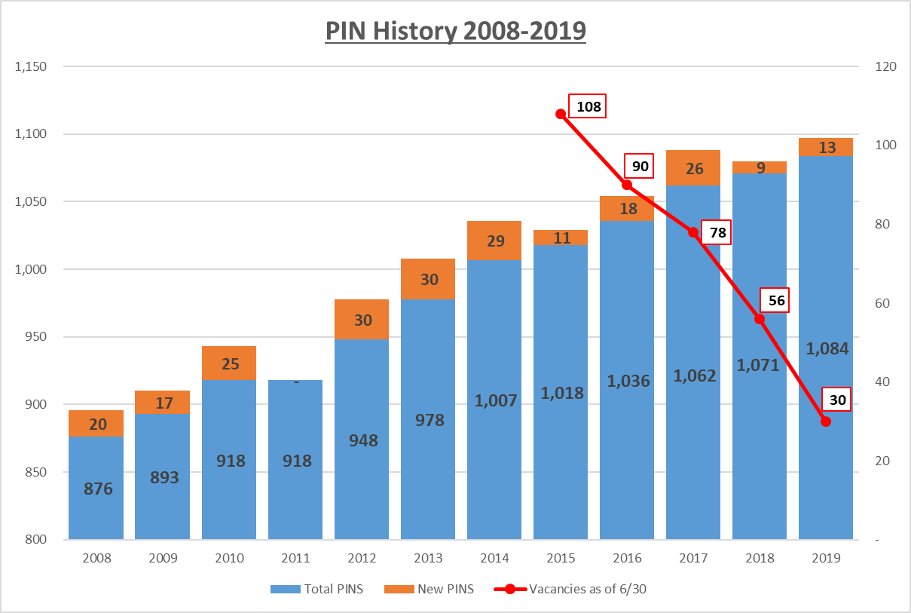
SU Budget Trend

Slide 24
SU Budget Trend

Slide 25
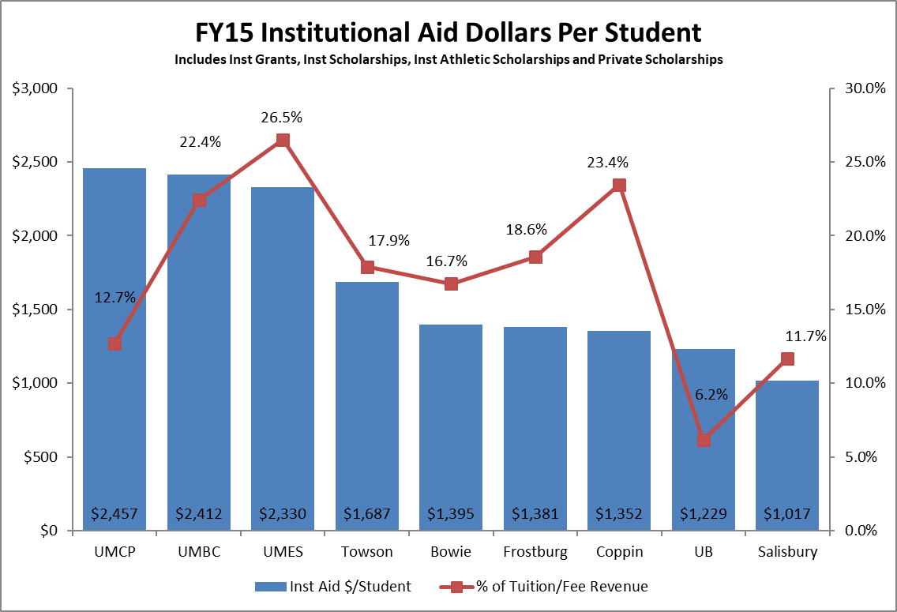
SU Budget Trend

Slide 26
"Takeaways"
Cannot count on a significant – or any - increase in State appropriation
PINS: no new PINS or very limited (enhancements only)
Enrollment and Student Credit Hour trends are vital
More efficient use of current funds (expenses)
Identify current discretionary uses, inefficiencies, low priority usage and other opportunities for reallocation

Slide 27
Student Affairs: Noel Levitz

