Slide 1


Adjunct Welcome Back
7th Annual
Adjunct Welcome Back
Part I: General Interest
Part II: New Adjunct Orientation

Slide 2
Adjunct Welcome Back
POSITIVE OUTCOMES!
Parking
Existing Policy (9/1/16 – 8/31/17): $40 Overload Faculty (Red): Overload faculty teaching 4 credit hours or less per semester during the day.
New Policy (9/1/17 – 8/31/18): $40 Adjunct Faculty (Red): Adjunct faculty teaching 8 credit hours or less per semester during the day.
Wage Increase
9.2% increase; $833 → $910/credit
Rate will be adjusted with any State COLA and/or Merit salary adjustments.*

Slide 3
Adjunct Welcome Back
ENROLLMENT and STAFFING TRENDS
from an
ADJUNCT PERSPECTIVE

Slide 4
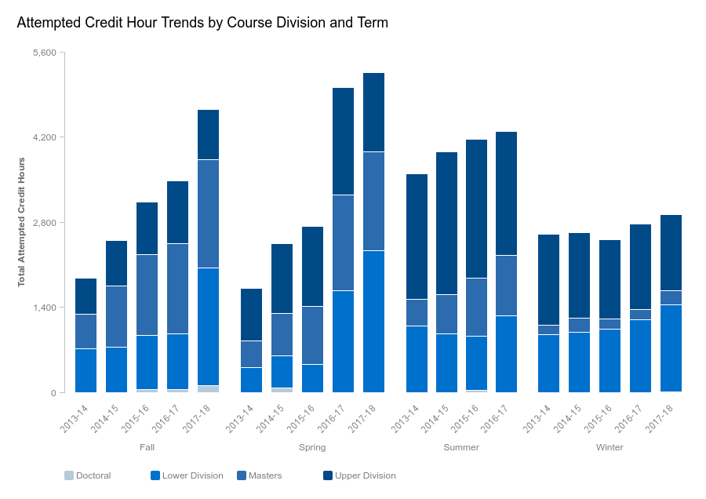
Adjunct Welcome Back
Fully Online Credits

Slide 5
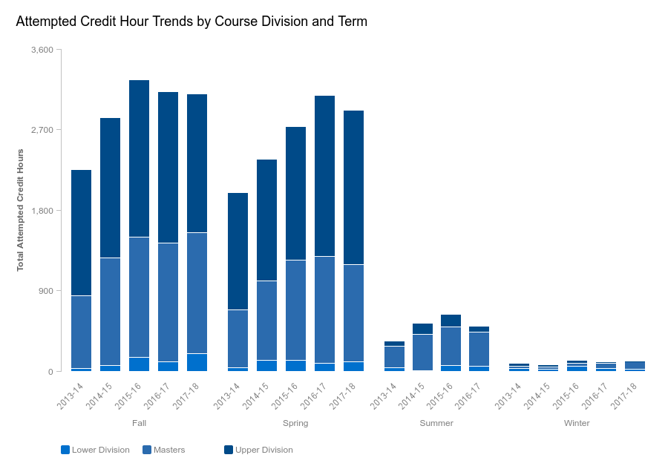
Adjunct Welcome Back
Satellite Operations

Slide 6
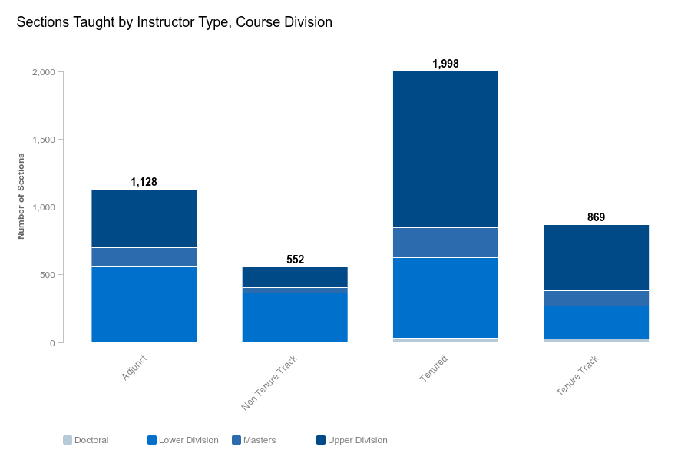
Adjunct Welcome Back
AY 2016-2017
Adjuncts taught 25% of sections

Slide 7
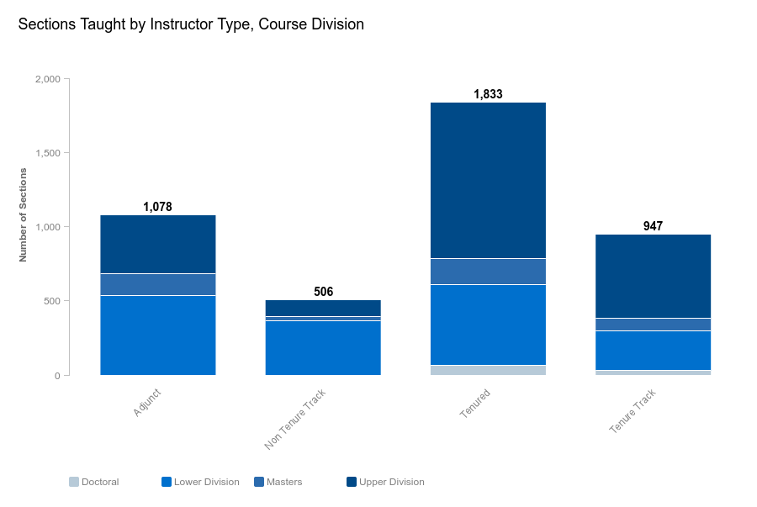
Adjunct Welcome Back
AY 2017-2018*
Adjuncts taught 25% of sections

Slide 8
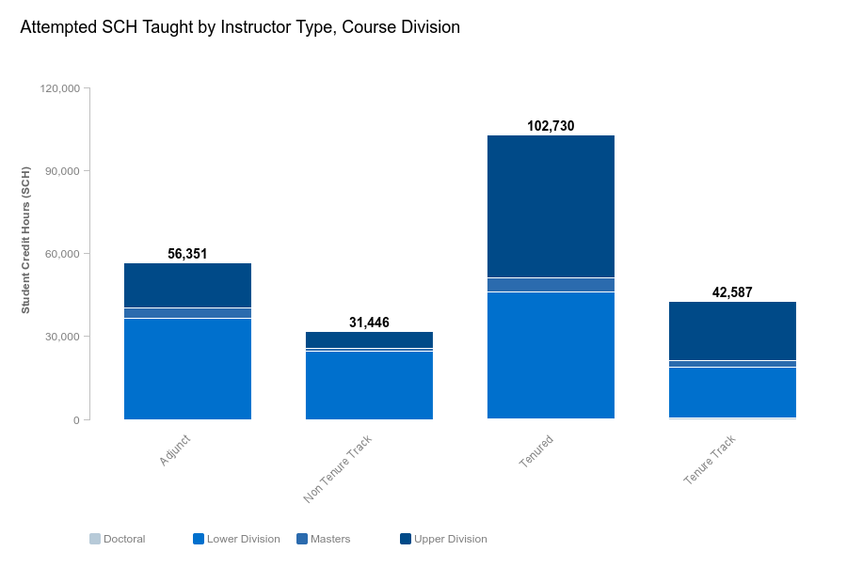
Adjunct Welcome Back
AY 2016-2017
Adjuncts taught 24% of student credit hours

Slide 9
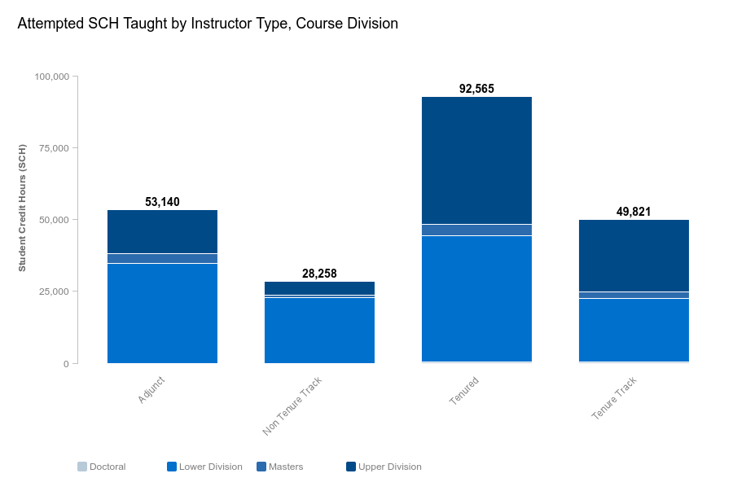
Adjunct Welcome Back
AY 2017-2018*
AY 2016-2017
Adjuncts taught 24% of student credit hours

Slide 10
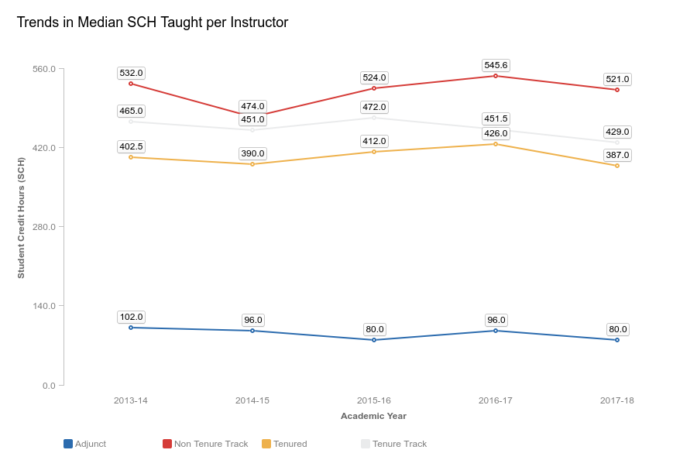
Adjunct Welcome Back

Slide 11
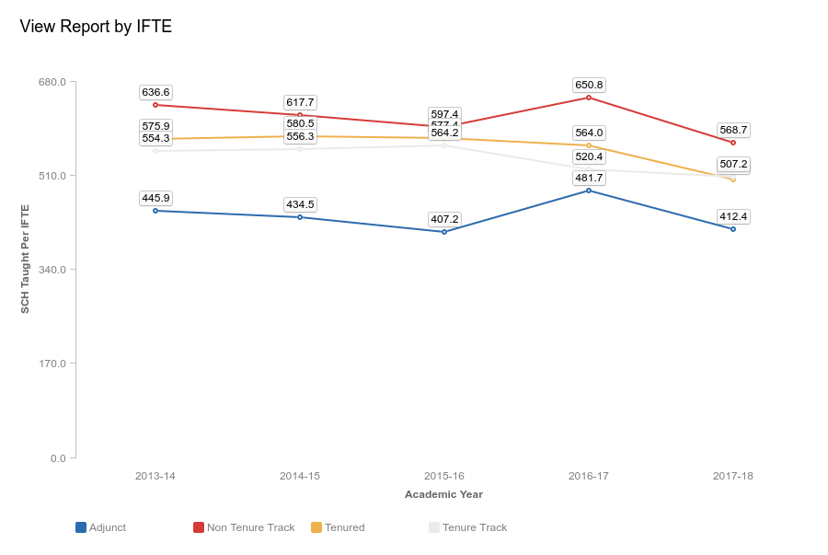
Adjunct Welcome Back

Slide 12
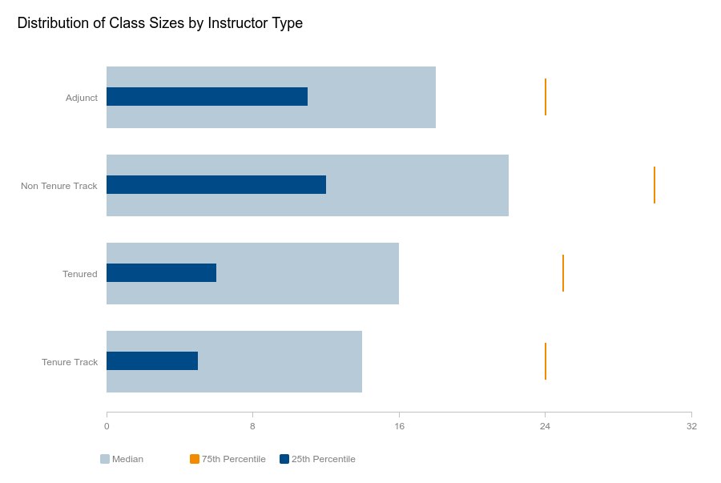
Adjunct Welcome Back

Slide 13
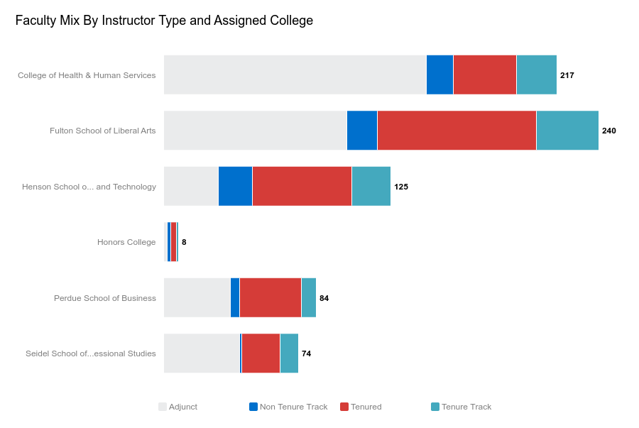
Adjunct Welcome Back

Slide 14
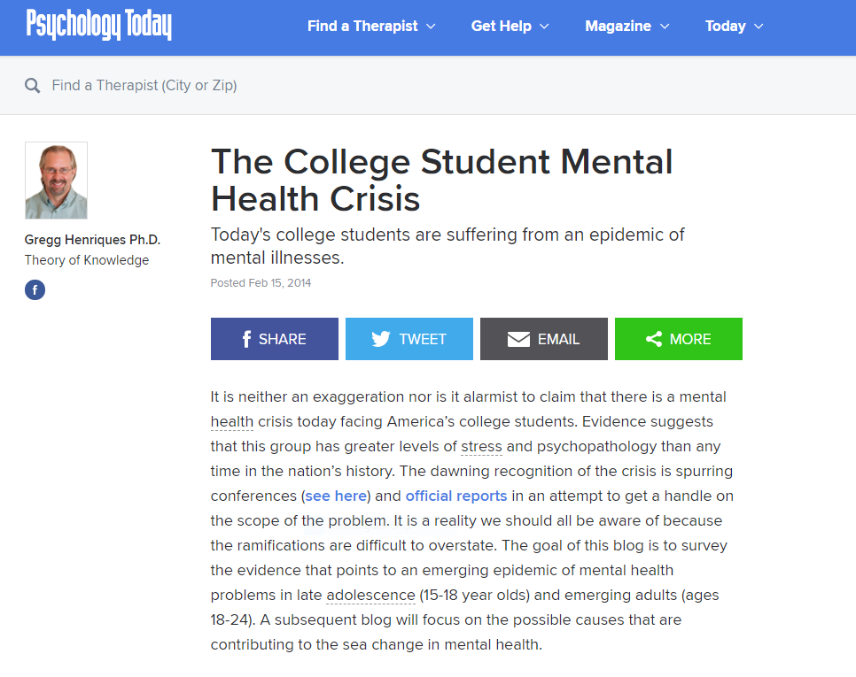
Adjunct Welcome Back

Slide 15
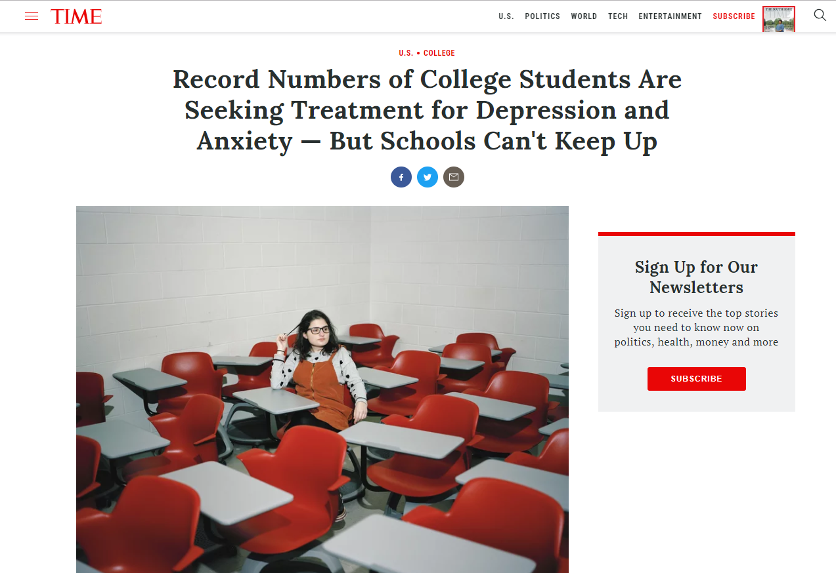
Adjunct Welcome Back

Slide 16
Adjunct Welcome Back
SU Cares:
Creating a Culture of Care
in the Classroom:
Mental Health and Wellness Update
A Presentation by Student Affairs colleagues

Slide 17
Adjunct Welcome Back
Thank You
and
Welcome back!
Questions or Comments?

Slide 18
New Adjunct Orientation
1st Annual
New Adjunct Orientation
This is a brief overview!
Please feel free to ask questions.
Write down questions and send to me.

Slide 19
New Adjunct Orientation
You are not alone.
Other faculty members in the Department
Adjunct Caucus Members
We are all here to help!
Deans
Department Chairs
Instructional Design & Delivery
Provost’s Office
Student Affairs

Slide 20
New Adjunct Orientation
GETTING STARTED
ID Cards
Gull Card Office: Commons Building, Rm 036 across from bookstore
Used as a key for most rooms
Use as a payment card
E-mail
Faculty/Staff E-mail setup: see pdf
http://www.salisbury.edu/helpdesk/doc/Email_Outlook_Exchange/Outlook_FacultyStaff/faculty-email-setup---general-instructions.pdf
SU Helpdesk is always a resource
Parking
General information: http://www.salisbury.edu/parking/default.html
To purchase a permit, see Parking Services Webpage, FAQ #6 – “How do I purchase a parking permit?”
http://www.salisbury.ed/parking/questions.html

Slide 21
New Adjunct Orientation
TEACHING
Syllabi preparation
Individual departments may vary → check with your department chair.
Do Include
Catalog Description of Course
Professor's name
Contact information
Office hours
Student learning objectives
A list of any books or materials to be purchased for the course
A course schedule
The grading policy
Attendance policy
NOTE: some of the above items may be embedded into your MyClasses course, but then you should note that in your syllabus.
See handout for other University policies and resources to include in your syllabus or as a link on your MyClasses course.

Slide 22
New Adjunct Orientation
Rosters and Classroom Assignments
Some General Points
All information and processes done through GullNet
Log in early; DO NOT wait until late in the semester when grades are due!
Official record keeping vital part of a professor’s duty
Call registrar/Help Desk → We will help you!
Should you add a student?
Confer with Chair on Departmental policies
Best practice is to not exceed class maximum capacity

Slide 23
New Adjunct Orientation
Locked out of the classroom?
Call University Police at
410-543-6222

Slide 24
New Adjunct Orientation
Student Records/Reporting
Roster Verification
GullNet
Why so important? → Identify potential problems
Students may think they are registered, but they are not → get them to register asap
Students may think they are in the correct class, but they are not → get them to the correct class!
Students are missing from class → We need to identify those students and reach out and determine the reason for their absence.

Slide 25
New Adjunct Orientation
Student Records/Reporting
Midterm Grade Reporting
GullNet
Why so important?
Identify students missing from class.
Intervention for struggling students → We will reach out to every student that you flag with an academic concern.
Make sure you plan several assessments to enter a meaningful midterm grade

Slide 26
New Adjunct Orientation
Student Records/Reporting
Final Grade Reporting
GullNet
Should be completed 48 hours after final exam.
Note: special attention may be required for graduating students

Slide 27
New Adjunct Orientation
Problem with classroom tech?
Call Technology Support Services
410-677-5454

Slide 28
New Adjunct Orientation
Meeting with students
Academic Commons 130 is available for adjuncts to reserve through SU Libraries Website by clicking the following links:
SU Libraries/Library Services/Group Study Rooms/Adjunct Faculty Space

Slide 29
New Adjunct Orientation
Class Cancellations – non-Weather
Communicate
Notify students as quickly as possible → Use GullNet by opening your class roster and hitting “contact all”
Email/contact Department Chair
Email Department Administrative Assistant (Call during business hours to request sign be placed on classroom door)
Options
If possible, schedule an academic activity online or as an assignment
Ask a colleague to cover for you

Slide 30
New Adjunct Orientation
Class Cancellations –Weather-related
Notification will come from the campus: online and text notification (if you have singed up for that service).
You may require your students to do an assignment through email or MyClasses.
Inclement Weather Policy
http://www.salisbury.edu/info/Weather.html

Slide 31
New Adjunct Orientation
Final Exam
A final exam is not required; however…
You must hold some type of academic activity during the dates designated as test dates
Note: if a student has three exams scheduled for the same day, they may ask for a rescheduled final exam date.

Slide 32
New Adjunct Orientation
POLICY COMPLIANCE
Office of Institutional Equity (OIE)
Title IX mandatory online training – “Intersections: Preventing Harassment & Sexual Violence”
Mandatory antidiscrimination training – “Managing Bias”
Acceptable Use of Technology (IT)
General: http://www.salisbury.edu/helpdesk/doc/HelpDesk/Policies/Policies_AcceptableUsePolicy.pdf
Email: http://www.salisbury.edu/helpdesk/doc/HelpDesk/Policies/Policies_SUEMailServicesAcceptableUsePolicy.pdf
Child Abuse
“University Professional Employees. A Professional Employee, when acting in a professional capacity, who has reason to believe that a Child has been Abused or Neglected is required to report suspected Child Abuse or Neglect.”
http://www.salisbury.edu/president/bor_policies/section_VI/Child_Abuse_and_Neglect_Policy_SU_FINAL.pdf

Slide 33
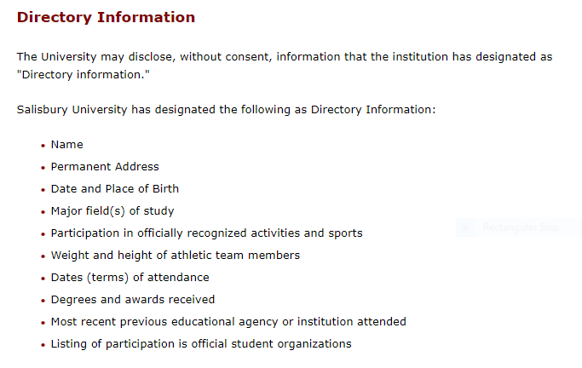
New Adjunct Orientation
FERPA (Family Educational Rights and Privacy Act)
Likely to be a mandatory training
Policy: http://www.salisbury.edu/registrar/Resources/FERPA/

Slide 34
New Adjunct Orientation
STUDENT CONDUCT
Conduct and Behavior
Academic Misconduct
A short presentation by the Dean of Students

Slide 35
New Adjunct Orientation
ACADEMIC GRIEVANCE PROCESS
Process is spelled out in Faculty Handbook
Student confers with professor → Chair → Formal complaint process including a University Committee → Appeal to the Provost
Take-home messages:
There is a process that starts with a professor/student dialog
The process is to ensure the rights of the student AND professor

Slide 36
New Adjunct Orientation
Resources for Students
Student Affairs Case Manager
Counseling Center
Center for Student Achievement
Disability Resource Center
Health Center
Career Services
Academic Advising Center
Writing Center
Math Tutoring
A short presentation by our colleagues in Student Affairs

Slide 37
New Adjunct Orientation
Adjunct Caucus and Shared Governance

Slide 38
New Adjunct Orientation
We are all here to help!

Slide 39
New Adjunct Orientation

Slide 40
New Adjunct Orientation

Slide 41
New Adjunct Orientation

Slide 42
New Adjunct Orientation

Slide 43
New Adjunct Orientation

Slide 44
New Adjunct Orientation

Slide 45
New Adjunct Orientation

Slide 46
New Adjunct Orientation

Slide 47
New Adjunct Orientation

Slide 48
New Adjunct Orientation

Slide 49
New Adjunct Orientation

Slide 50
New Adjunct Orientation

Slide 51
New Adjunct Orientation

Slide 52
New Adjunct Orientation

Slide 53
New Adjunct Orientation

Slide 54
New Adjunct Orientation

Slide 55
New Adjunct Orientation

Slide 56
New Adjunct Orientation

Slide 57
New Adjunct Orientation

