Slide 1
Do you need a Gap Year?
There are several reasons why you may need time, (after graduation), before applying to a post baccalaureate health professions program.

Slide 2
Here are a few common reasons
You need to complete the pre-requisites required for admission and “sit” for the health profession entrance exam (MCAT, DAT,GRE, PCAT).
You completed the pre-requisites during your final year of undergraduate school and still need to “sit” for the health profession entrance exam.

Slide 3
Reasons continued…………
You want to enhance your health related experiences.
You want to pursue research opportunities.
Your MCAT/DAT/GRE/PCAT score was lower than you anticipated.
A gap year is CONSTRUCTIVE time ; it can be anywhere, anytime, doing anything, but you need a plan.

Slide 4

To Be a Successful Gapper
Write a preliminary goal statements for your year off. Include strategies for monitoring and assessing your progress.
Be prepared to answer questions that will potentially be asked by employers or graduate school admissions personnel.

Slide 5
What Should You Do?
The reason that you decide to take a “gap year”, determines what you should do in-between.

Slide 6

Do you wish you would have…
Had an internship?
Had more extensive health related experiences?
Studied abroad?
Taken a foreign language?
Chosen a minor?
Prepared more effectively for your standardized exam?

Slide 7



What can you do during a Gap Year?
Get a one year internship
Get a one year job
Help yourself
Help others
Do the above outside of the USA when you couldn’t before

Slide 8
Some Suggestions
Diligent preparation for the health professions entrance exam. Think about the Kaplan or Princeton Review Course . www.princetonreview.com orwww.kaptest.com
Prepare your application and submit it to the application service. Depending on the time of year, the interval between your primary application filing and hearing of an interview, may be three months or more.
Applications submitted in July will be reviewed by early September, whereas applications completed in the fall will not be reviewed until winter. Remember, “the early bird gets the worm”!

Slide 9
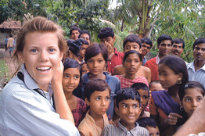
Suggestions continued……
Consider USA and International Service Programs like Americorps, the Peace Corps, and International Service Learning.
www.gapyearprograms.net
www.islonline.org
http://www.gapyearjobs.co.uk/
http://www.realgap.co.uk/

Slide 10



Suggestions continued……
Volunteers.gov
http://www.habitat.org
http://www.redcross.org/
http://www.americorps.gov/

Slide 11

Don’t forget SU Career Services!
http://www.salisbury.edu/careerservices/
Students/Volunteers/OpportunitesWorlwide.html
http://www.salisbury.edu/careerservices/
Students/GapYear.html

Slide 12
Suggestions continued……
Consider a biomedical science or a post-baccalaureate program designed for students interested in pursuing medicine. Biomedical science programs may be Master’s programs or certificate programs.
www.pcom.edu
www.biomed.drexel.edu
http://services.aamc.org/postbac/getprogs.cfm

Slide 13
What is a Biomedical Science Certificate Program?
Offers students the integrative scientific study of biological issues related to health and medicine. Can be completed in one year.
Many students seek this coursework in order to prepare for a career in one of the health professions.
It can address the needs of a variety of students who are second career or in need of enhancing their academic record.

Slide 14
What is a Postbaccalaureate Pre-medical Program?
Some are designed for students who have not completed the science courses required for medical school.
Some are designed for students who need to enhance an existing academic record. They have completed the required science courses, but must improve their GPAs to be competitive for admission.

Slide 15
Suggestions continued……
Consider pursuing research through NIH post baccalaureate programs: the intramural research training program and the NIH Academy.
www.training.nih.gov/programs
Consult other federal government opportunities.
http://www.salisbury.edu/careerservices/Students/Government/Federal.html

Slide 16
Suggestions complete
Consider medical programs that put less emphasis on the health professions entrance exam score and more emphasis on your health exploration experiences, motivation, and overall GPA.
(Ross University, American College of Antigua)
Retake the health professions entrance exam.

Slide 17
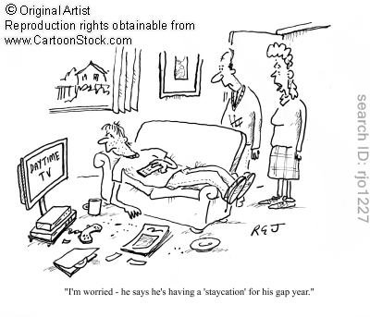
What happens when you don’t have a plan?

Slide 18
Elements of Your Gap Yea r Plan
Timeline
Updated resume, including communication with HPAP and your reference letter writers
Application and entrance exam fees
Living expenses
Transportation costs
Medical insurance coverage while you’re no longer a student

Slide 19
REMEMBER………….
Regardless of what you are planning with your gap year, you must continue to keep up with medical advancements and national trends.

