Slide 1
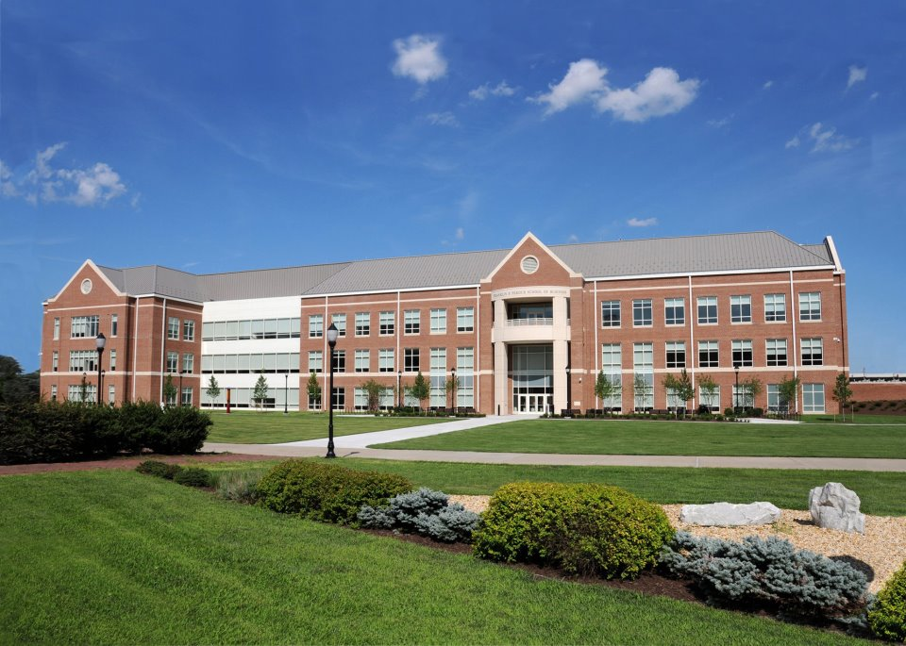
THE Meeting
BUAD 300 Requirement
Three Sessions:
Opening, Breakout, Resource

Slide 2
THE Meeting allows business students the opportunity to learn more about the process to:
Transition from pre-professional to professional
Hear from faculty from their major
Engage with other departments and students
MEETING

Slide 3
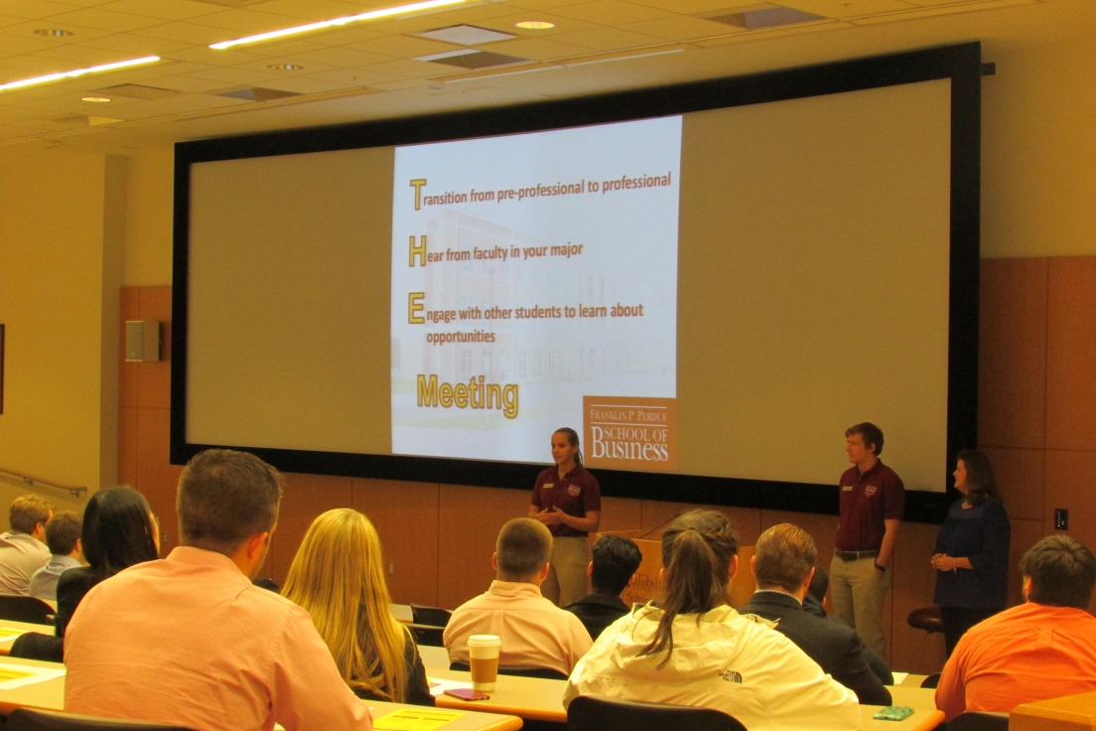
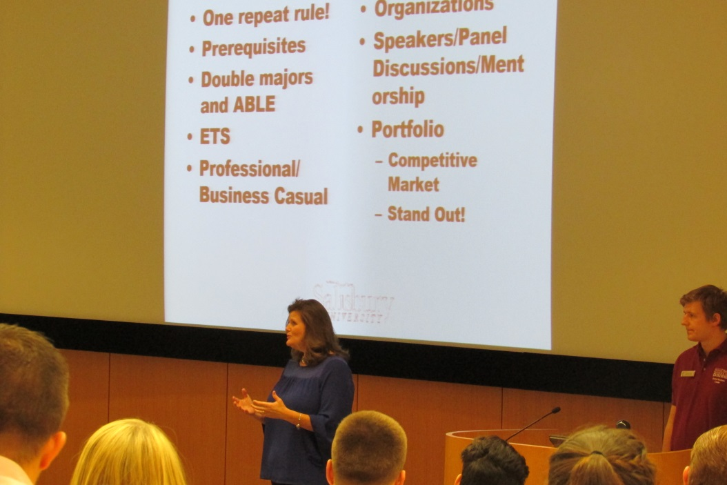
Opening Session
Student Business Leaders explain what THE Meeting is about.
Dean Christy Weer speaking to students about the professional program

Slide 4
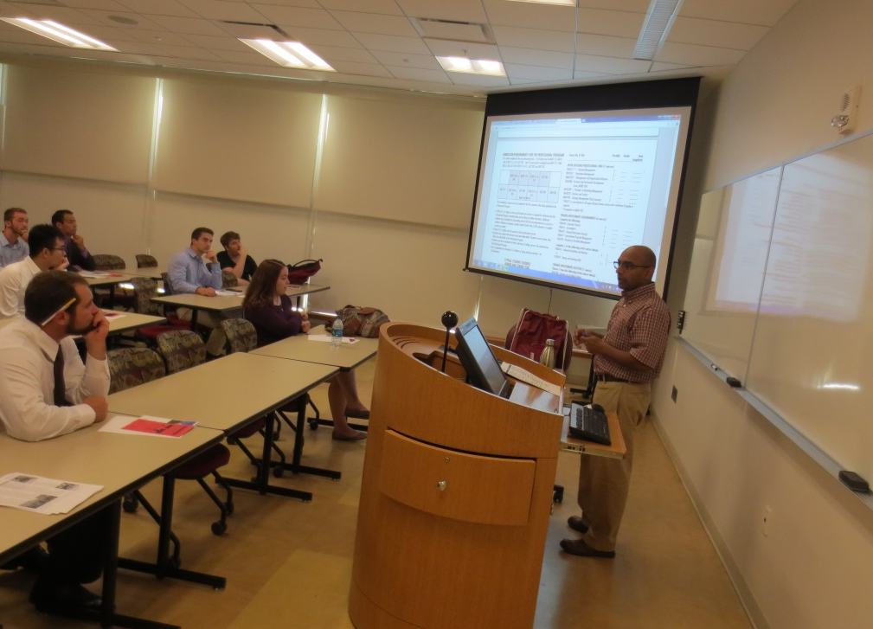
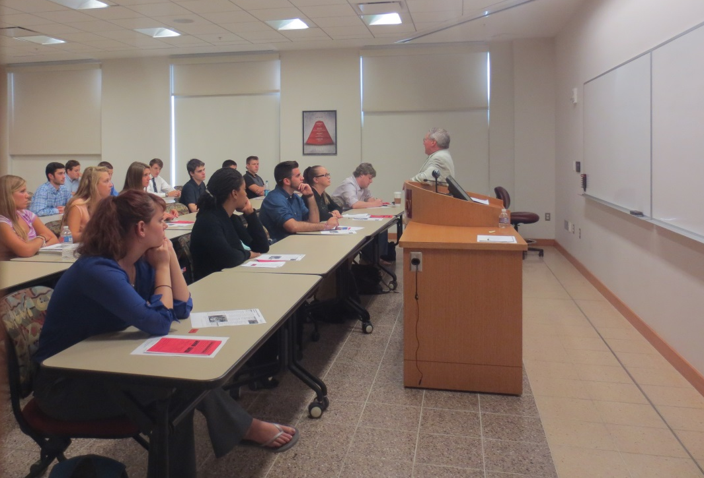
Breakout Session
Breakout sessions allow students to meet professors from their major and learn about the different courses required to graduate.

Slide 5
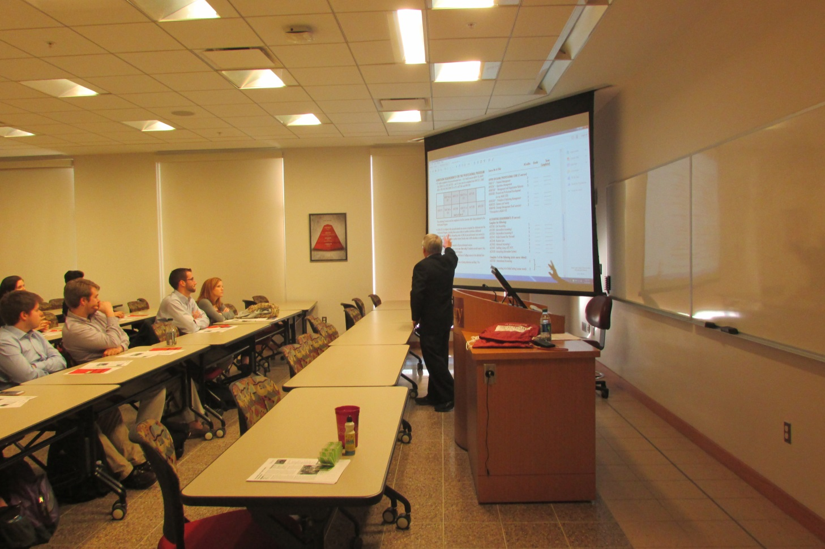
Breakout Session
“The breakout meeting was very informative of all the different finance tracks.”
Professors come to speak about each individual major.

Slide 6
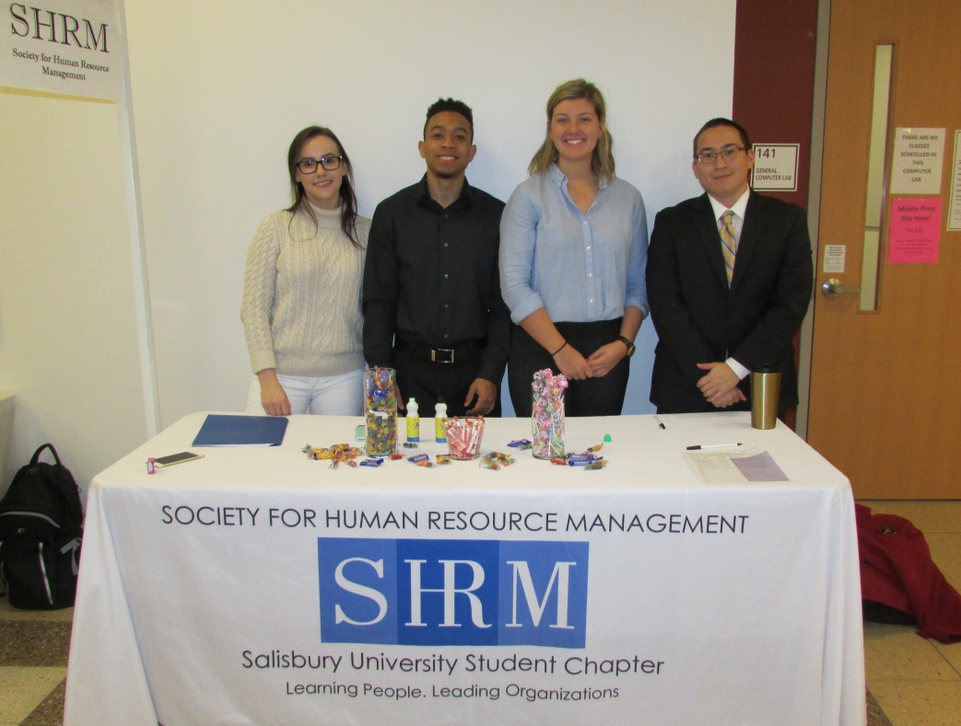
Resource Session
Various organizations at Salisbury University come to THE Meeting to offer opportunities outside of the classroom for business students.
Students are required to visit two clubs and two non-clubs to receive credit.

Slide 7
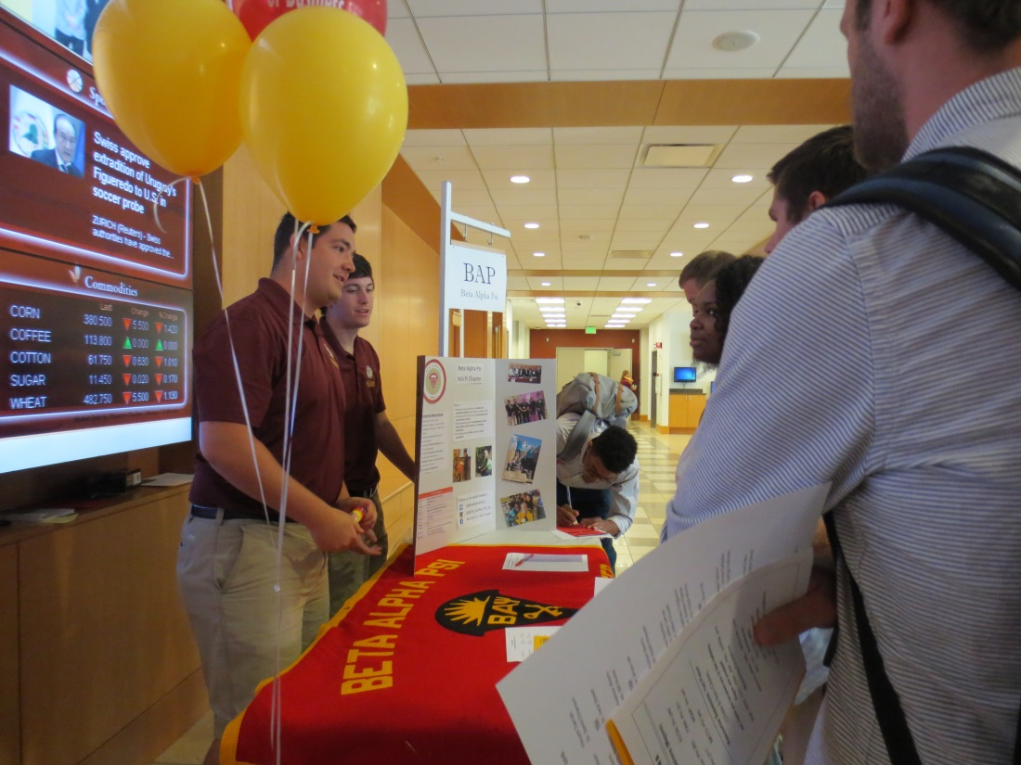
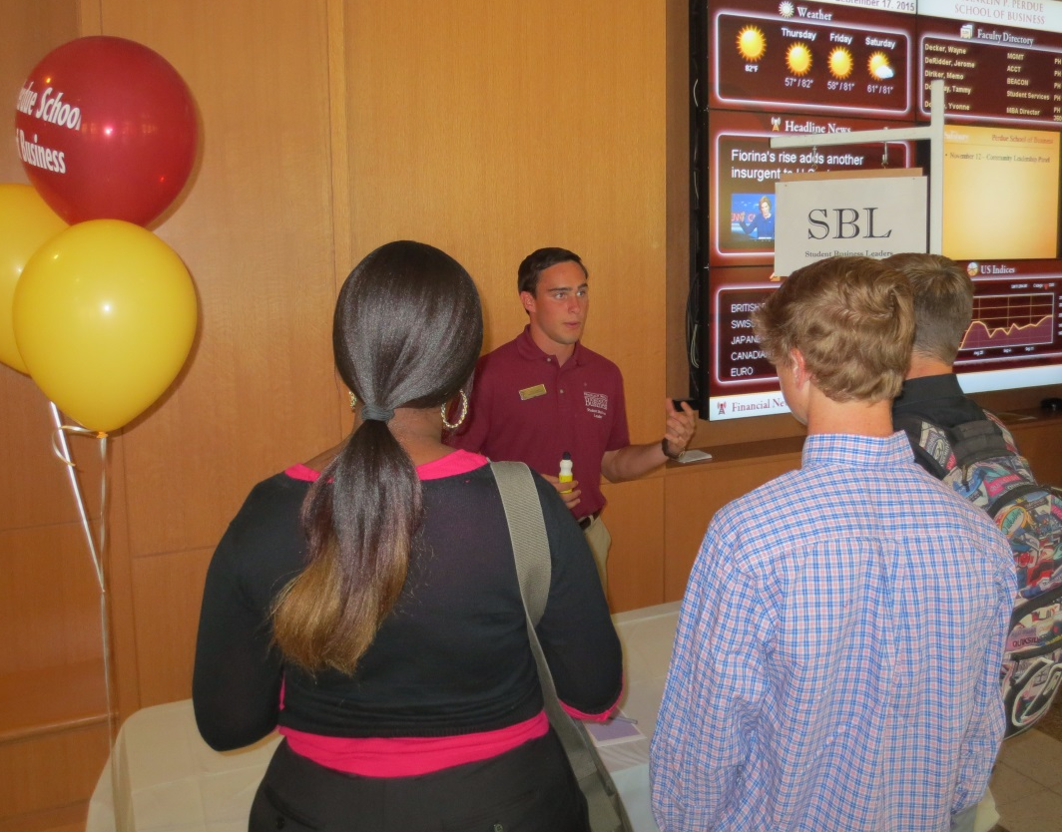
Resource Session
Students are able to talk directly to members of different clubs to learn more about them.

Slide 8
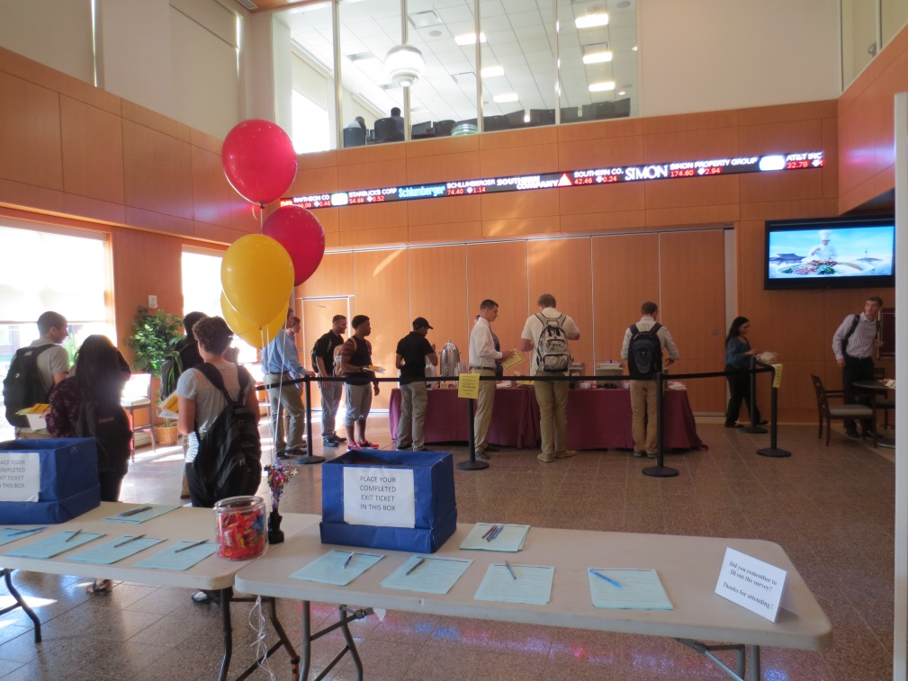
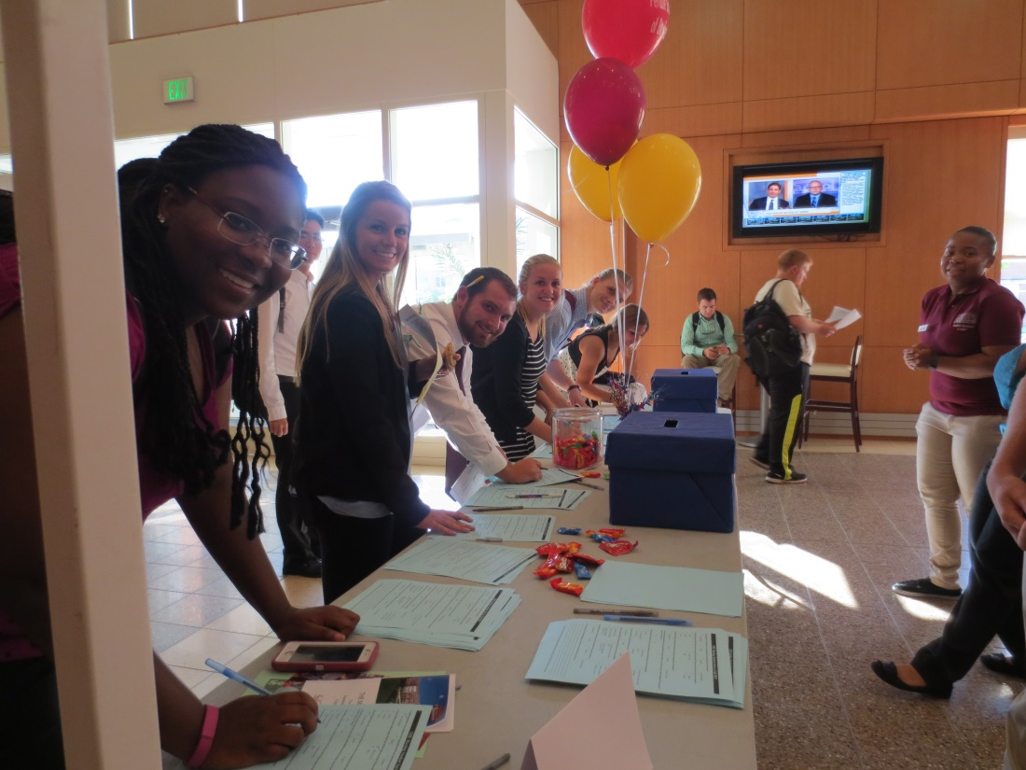
Exit Ticket
Students are asked to fill out a survey about THE Meeting.
Candy is always a good incentive.

